Slide 1


A common XML query/response model for automated publication-to-registration pipeline
Lyubomir Penev, Jordan Biserkov,
Teodor Georgiev, Pavel Stoev
Pro-iBiosphere Workshop, 11-15 February 2013, Leiden
ViBRANT
Notes:
Hello,
This short presentation is meant to frame the discussion and review the challenges of registration of names.

Slide 2

Current status of registration rules
FUNGI
Pre-publication registration mandatory for fungi since 1st of January 2013
Record identifiers must be published in the protologue
Three official registries approved: MycoBank, Index Fungorum, Fungal Names
PLANTS
Post-publication indexing is a well-established practice of IPNI
Mandatory pre-registration and inclusion of record identifiers in protologues pioneered by PhytoKeys
ANIMALS
Post-publication registration is a well-established practice of Zoological Record
Pre-publication registration at ZooBank mandatory since 1st of January 2012 for e-only
Record identifiers (LSIDs) should be published in the original description

Slide 3
The challenges of the registration process
Three main groups of players: registry curators,
authors, publishers
Who will be “allowed” to register new data in
electronic registries?
Who will validate (quality control) the registrations?
Who will supply the registry’s GUIDs (record numbers) to the publishers?
Who and when will add/correct the final article metadata upon publication?

Slide 4








A B
Two parallel workflows
AUTHOR or
REGISTRY AGENT
PUBLISHER
XML
Query
PRE-SUBMISSION
REGISTRATION
Accepted
MANUSCRIPT
PRE-PUBLICATION
REGISTRATION
Index Fungorum
MycoBank
IPNI
ZooBank
XML
MARK UP
Index Fungorum
MycoBank
IPNI
ZooBank
Publication
XML
Report
XML
Report
ARTICLES
Biblio-
graphies
Occurr-
ence data
Taxon treatments
Taxon names
Plazi
Wiki
COL
BHL
Notes:
Currently, there are 2 parallel workflows.
This increases the possibility for errors/duplication.

Slide 5
Publisher-to-registry automated pipeline
Step 1. XML query to the registry upon acceptance of the manuscript (containing the type of act, taxon names, and preliminary bibliographic metadata)
Step. 2a. XML query response containing the unique identifier (e.g., LSID, PURL, or other resolvable URLs) of the act and potential error messages
Step. 2b. Correcting potential errors and duplicates: human intervention, at either registry’s or publisher’s side (or at both)
Step. 3. Inclusion of identifiers in the published treatments (protologues, nomenclatural acts)
Step 4. Final XML report sent by publisher on the day of publication (exact bibliographic details of the published article: authors, title, journal, issue no, date of publication, pagination)
Notes:
It would be much better if we merge those two workflows together.
Alleviate the burden from the authors and automate the whole thing (or at least most of it).

Slide 6




Automated registration
Manuscript
SUBMISSION
Peer review
XML Query
MANUSCRIPT
ACCEPTED
XML Response
XML article metadata
ARTICLE
PUBLISHED
Taxon name available/valid
(effectively published)
Notes:
Once the article is approved for publication,
an XML query is sent to the appropriate registry.
The registry responds with the identifiers for the taxonomic act.

Slide 7
Which acts to register?

Slide 8
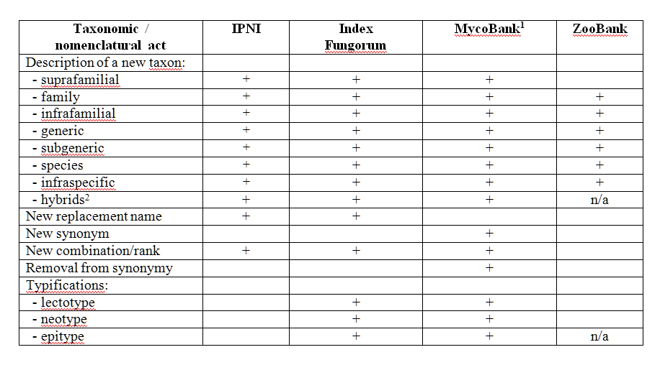
Which acts to register?
Notes:
The different registries support a different set of taxonomical acts and save different pieces of information.
This must be taken into account when designing the XML schema for the exchange format.

Slide 9
Questions to discuss/resolve
http://pwt.pensoft.net

Slide 10
The challenges of the registration process
A “common” XML registration model hardly possible!
Three workflows should be created
(and associated XML schemas)
Current status:
    IPNI (in testing phase)
    ZooBank (in discussion/testing phase)
    MycoBank (to be discussed)
    Index Fungorum & Fungal Names (IPNI or ZooBank?)
    Others (algae, fossils?)

Slide 11


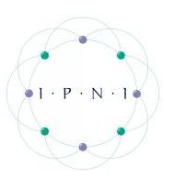
Acknowledgments
Plazi
ViBRANT

Slide 12
Thank you for your attention!
ViBRANT

