Slide 1


Making small data big!
The Biodiversity Data Journal (BDJ)
Lyubomir Penev, Jordan Biserkov, Teodor Georgiev,
Pavel Stoev, David Roberts, Vincent Smith
pensoft.net/journals/bdj
ViBRANT

Slide 2
One more new journal?
Why?

Slide 3
The problem

Slide 4
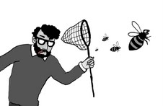
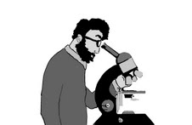

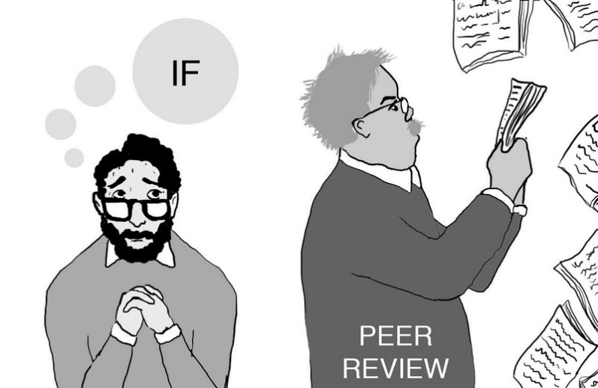
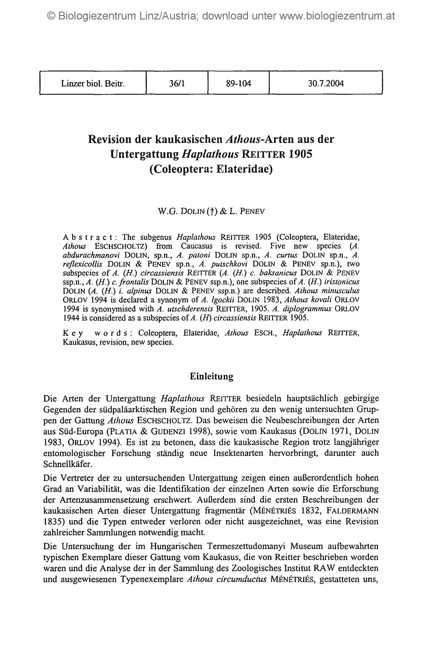




Drawings: slavenapeneva.com
Primary data

Slide 5
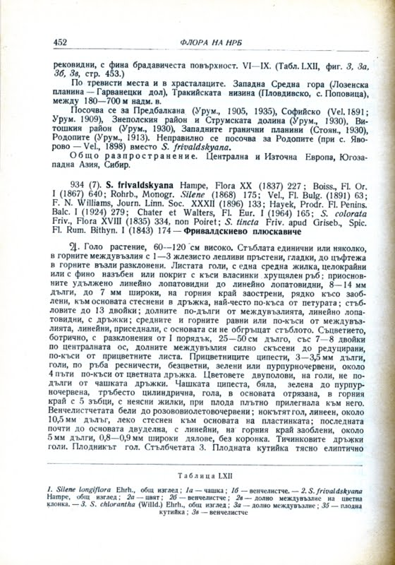
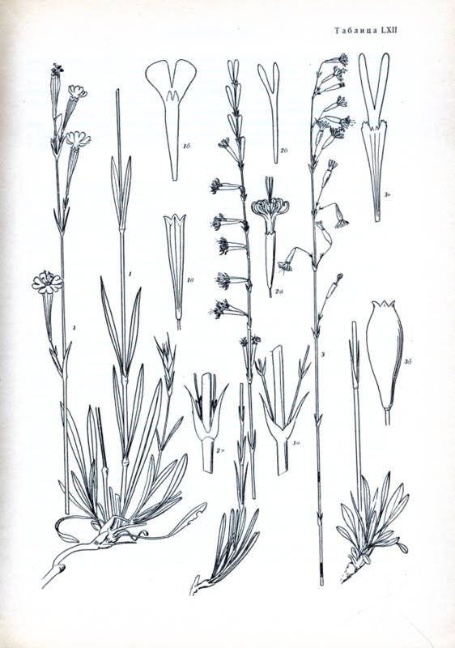
… and some hundreds millions pages of biodiversity literature in various languages

Slide 6
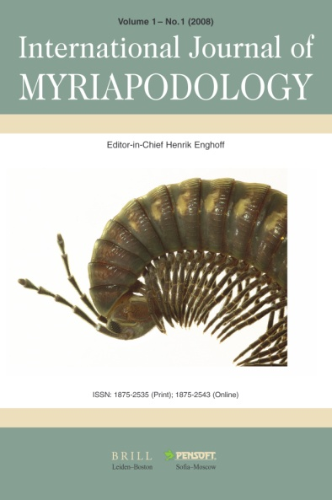


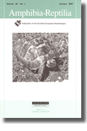

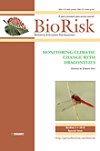
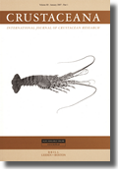
Estimated ca 1.8 Mio articles per annum, not counting the grey literature!

Slide 7
A solution

Slide 8
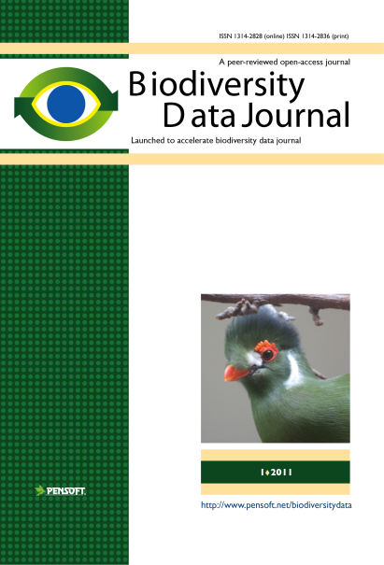
RE-USE
of
CONTENT
Publishing and sharing of primary data
Primary data

Slide 9

So, why one more new journal?
We need to encourage taxonomists to mobilize & describe their data, especially small data
This takes considerable effort
(e.g. GBIF, Scratchpads experience)
“Arguably” this is best rewarded through credit
This means papers and citations
Process must be very easy for authors
Process must facilitate data reuse
Meet “Open Data” policy commitments

Slide 10
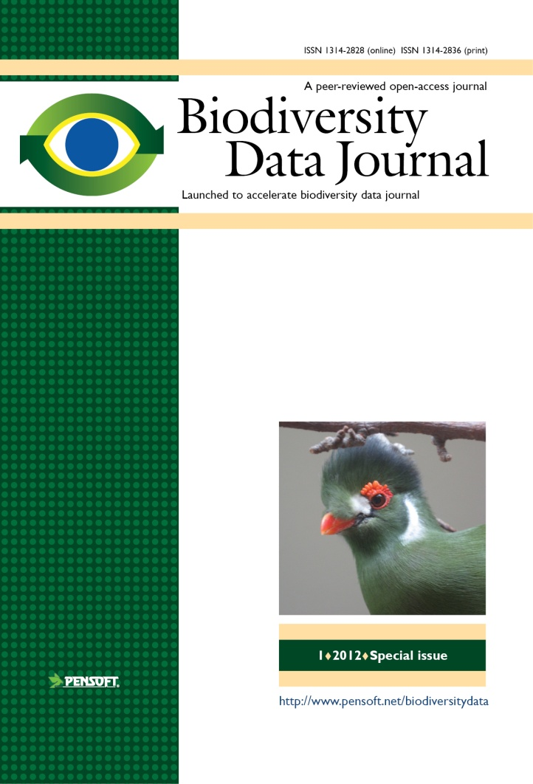
Key features
Collaborative article authoring
Online peer-review and editing
Community peer review; options for “open” and “public” review
Standard-compliant (DwC, NLM DTD)
Biological Codes compliant article templates
No lower/upper limit of manuscript size
Semantically enhanced “articles
of the future”
Integrated with GBIF, EOL, Dryad Scratchpads, etc.
ALL DATA MATTERS!

Slide 11
Notes:
11
Slide 12: Next generation article publishing
Arguably our most ambitious developments in the context of scholarly communication concern the semi-automated construction of scholarly papers from databases. In many cases Scratchpads contain extensive data relating to the biology and description of particular species. These are highly suited to formal specialist publications, but doing so require the laborious assembly of these data into a manuscript. As part of the ViBRANT collaboration with Pensoft, and in particular their two journals specialising in the formal taxonomic descriptions of plants and animals, we have developed a 5-step workflow for users to selecting appropriate data from their Scratchpad, adding additional metadata describing this information so that it conforms with the norms of descriptive taxonomic publications, and then finally preview and submit this manuscript to the publisher. From here is goes through a standard peer review process. Review recommendations are then incorporated in to a revised version of the manuscript, which is then sent back to the publisher and simultaneously published on both the Scratchpad and in the publisher’s journal.
In addition to dramatically speeding up the construction of scientific papers, the user has the advantage that firstly the manuscript can be revised and updated and new information comes to light on the Scratchpad, while preserving the original version of the manuscript as part of the scholarly record. In addition the publish extracts relevant information from the submitted database which is them automatically submitted to the specialist data repositories.
So in sum then, these are the four ways in which ViBRANT is facilitation scholarly communication of biodiversity information. 1) Through low cost journal infrastructure; 2) by community web publishing; 3) by biodiversity observation data publishing; and 4) by next generation publishing services producing scholarly articles from databases.

Slide 12
Automated submission
Automated XML submission
Notes:
12
Slide 12: Next generation article publishing
Arguably our most ambitious developments in the context of scholarly communication concern the semi-automated construction of scholarly papers from databases. In many cases Scratchpads contain extensive data relating to the biology and description of particular species. These are highly suited to formal specialist publications, but doing so require the laborious assembly of these data into a manuscript. As part of the ViBRANT collaboration with Pensoft, and in particular their two journals specialising in the formal taxonomic descriptions of plants and animals, we have developed a 5-step workflow for users to selecting appropriate data from their Scratchpad, adding additional metadata describing this information so that it conforms with the norms of descriptive taxonomic publications, and then finally preview and submit this manuscript to the publisher. From here is goes through a standard peer review process. Review recommendations are then incorporated in to a revised version of the manuscript, which is then sent back to the publisher and simultaneously published on both the Scratchpad and in the publisher’s journal.
In addition to dramatically speeding up the construction of scientific papers, the user has the advantage that firstly the manuscript can be revised and updated and new information comes to light on the Scratchpad, while preserving the original version of the manuscript as part of the scholarly record. In addition the publish extracts relevant information from the submitted database which is them automatically submitted to the specialist data repositories.
So in sum then, these are the four ways in which ViBRANT is facilitation scholarly communication of biodiversity information. 1) Through low cost journal infrastructure; 2) by community web publishing; 3) by biodiversity observation data publishing; and 4) by next generation publishing services producing scholarly articles from databases.

Slide 13


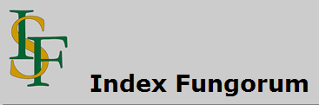
Automated registration
Manuscript
SUBMISSION
Peer review
XML Query
MANUSCRIPT
ACCEPTED
XML Response
XML article metadata
ARTICLE
PUBLISHED
Taxon name available/valid
(effectively published)

Slide 14
Multiple Data Publishing Models
Supplementary data files downloadable from the journals’ website
Data deposited at specialized data repositories (Dryad, Pangaea)
Data published through data repositories but indexed and collated with other data (GenBank, GBIF IPT)
Data published in the form of marked-up and machine-readable text (XML).
Extended use of multimedia and semantic enhancements

Slide 15
What will BDJ publish?
Single taxon treatments and nomenclatural acts
Local/regional and habitat-based checklists
Sampling reports and occasional inventories
Ecological and biological observations of species and communities
Identification keys
Data papers for any biodiversity-related type of data (genomic, phylogenetic, ecological, environmental, etc.)
Descriptions of biodiversity-related software tools and workflows

Slide 16








Life cycle of data published in the BDJ
Occurrence data
Any other data
Genome dada
Morphometric data
Biodiversity
manuscript
Phylogenetic data
Image galleries
Environmental
data
XML
MARK UP
Structured text
(data!)
ARTICLES
Biblio-
graphies
Occurr-
ence data
Taxon treatments
Taxon names
Plazi
Wiki
COL
BHL

Slide 17
Pensoft writing tool
(PWT)

Slide 18
Pensoft Writing Tool (PWT)
Collaborative online editing
Rich text capabilities
Various templates for taxon treatments
Identification keys builder
Assembling plates from single figures
References import (CrossRef, PubMed Central, etc.)
Contribitors
Mentor, lingustic editor, copy editor, colleague
Taxon treatment
Species occurrence data import
(Darwin Core compliant)
Smart citation for figures, tables, references & automated positioning
Template
based
Interactive key
manuscript creation
Checklist
Lead author
Data paper
Coauthors

Slide 19
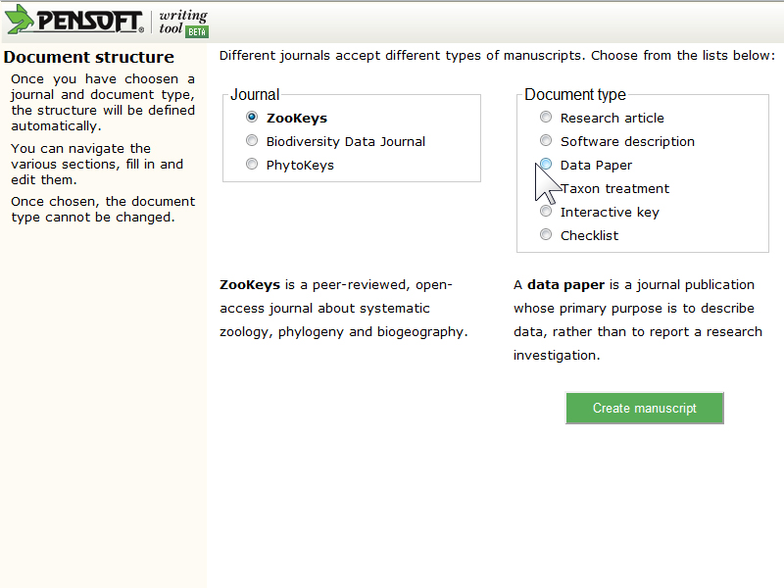
Choose article template

Slide 20
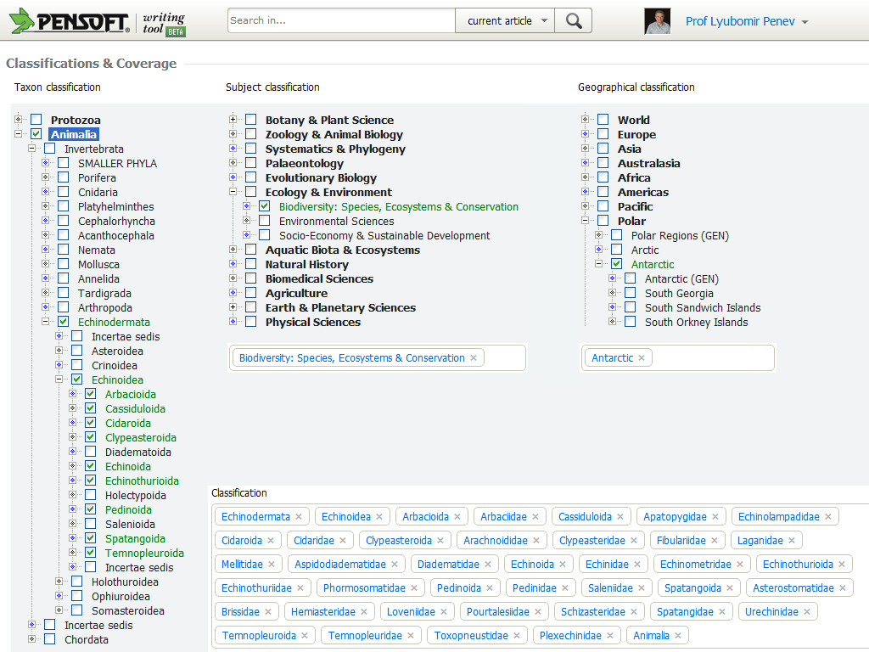
Assign classifications

Slide 21
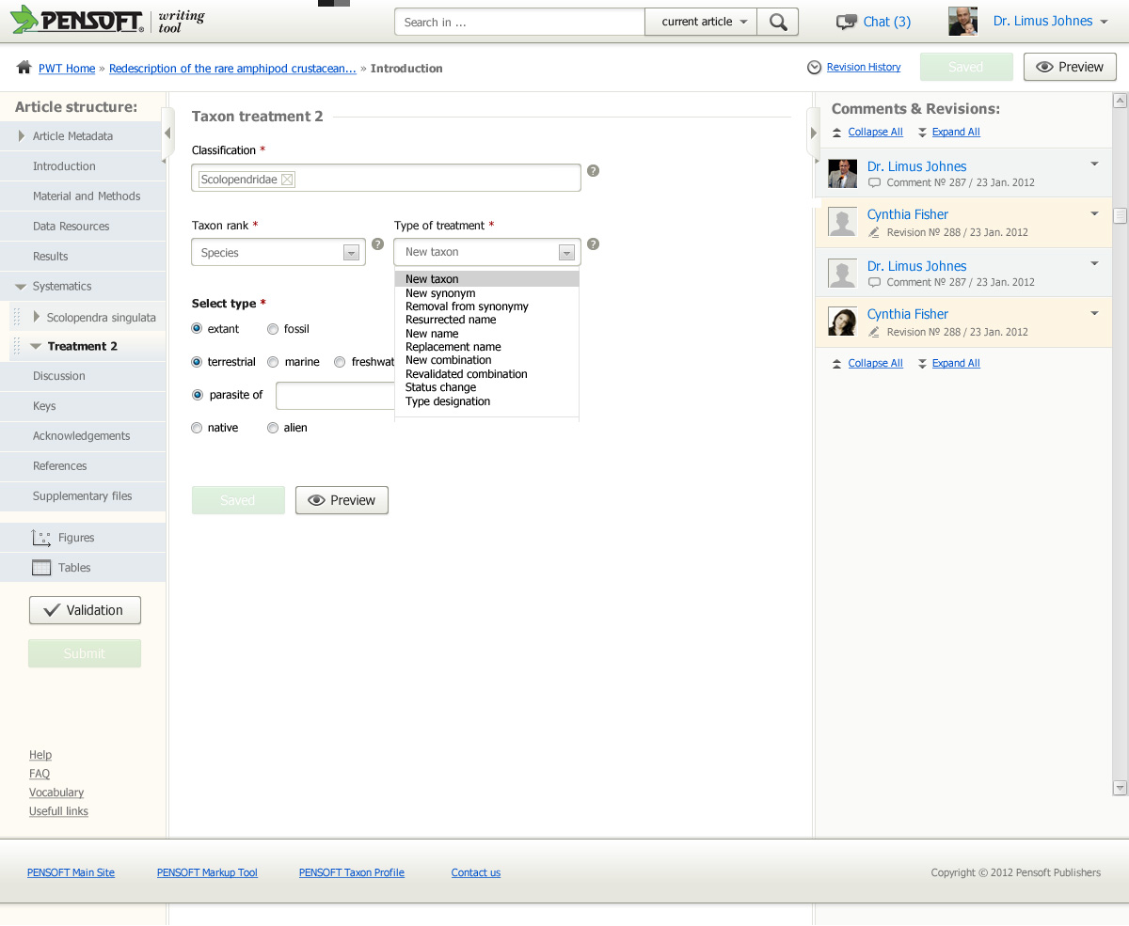
Create taxon treatment

Slide 22
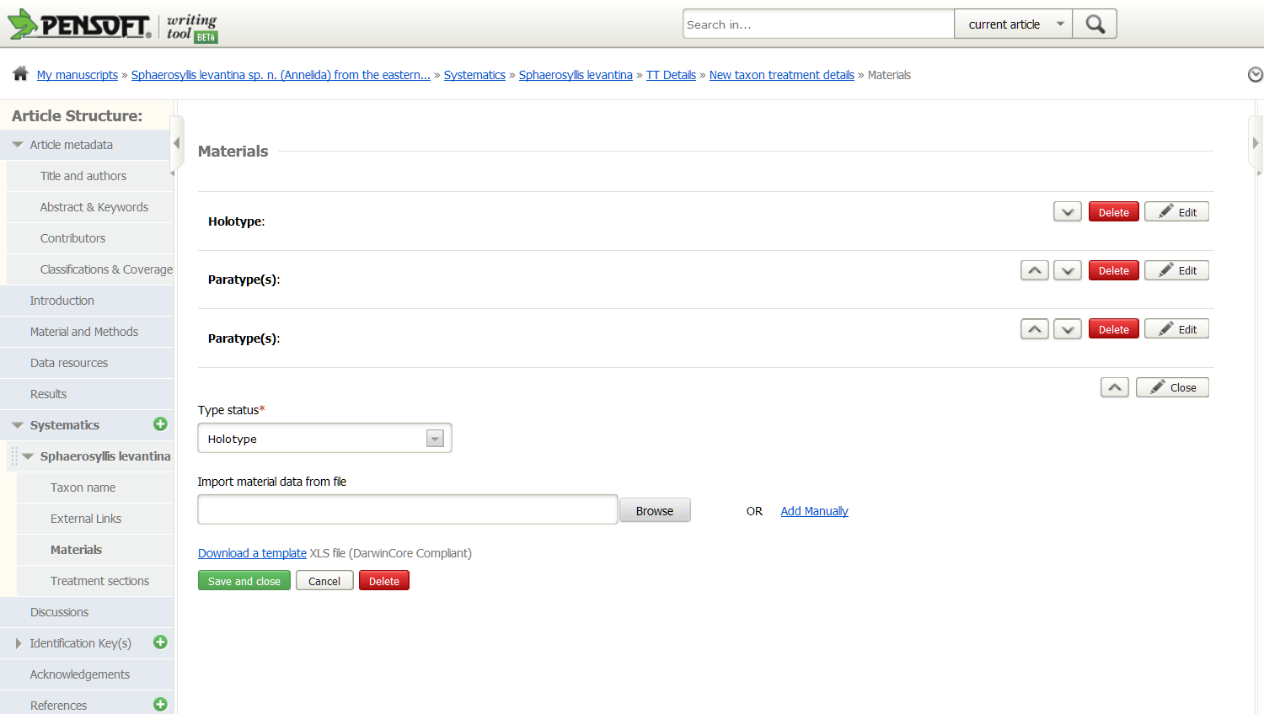
Add occurrence data

Slide 23
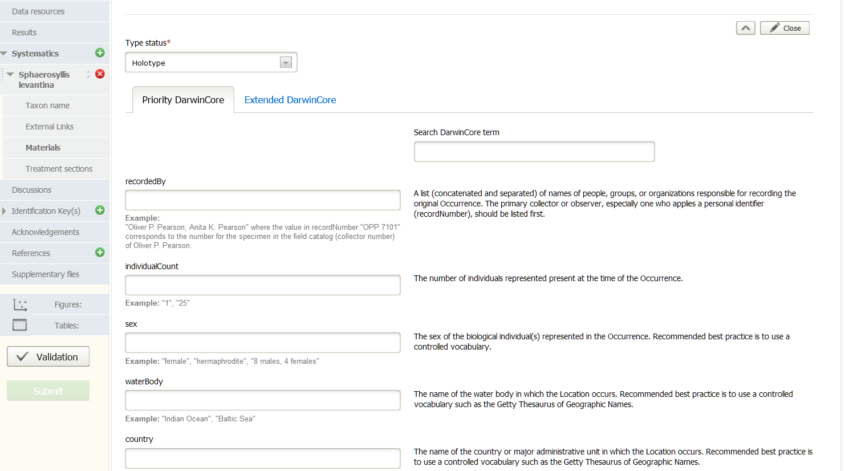
DarwinCore occurrence data form

Slide 24
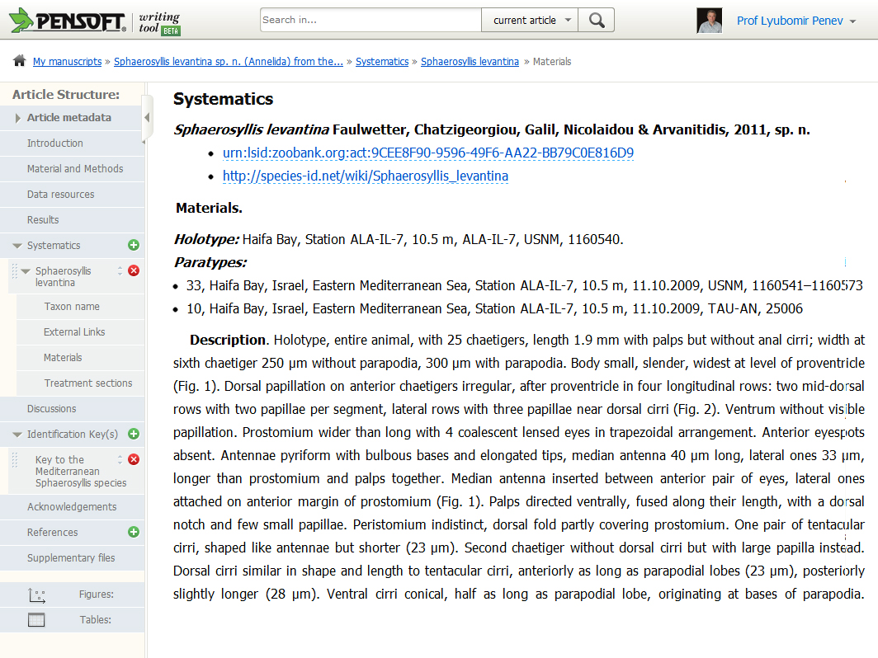
Taxon treatment preview

Slide 25
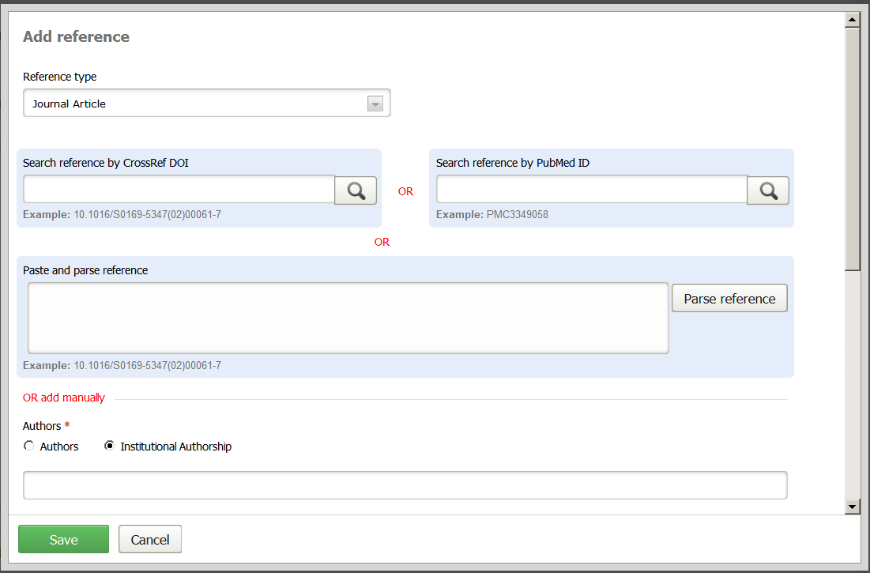
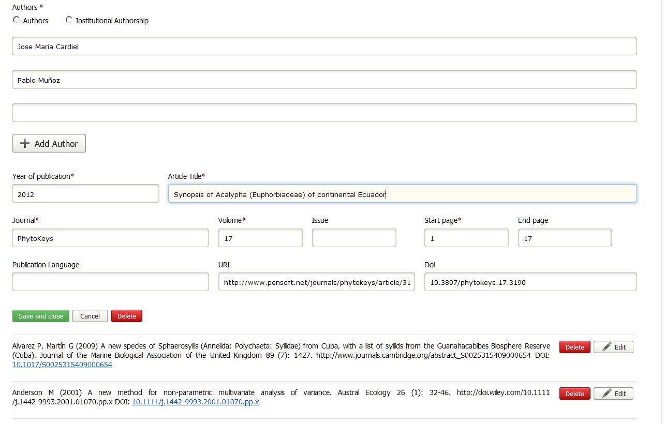
Add reference
10.3897/phytokeys.17.3190

Slide 26
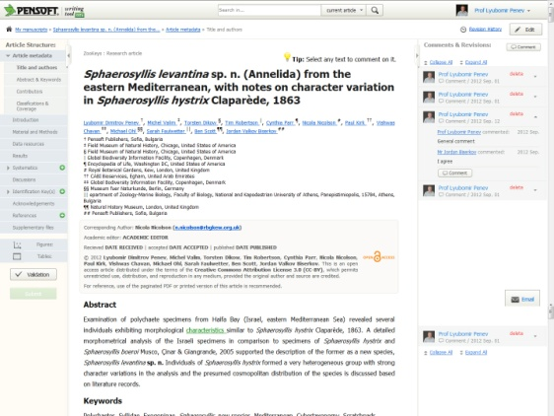
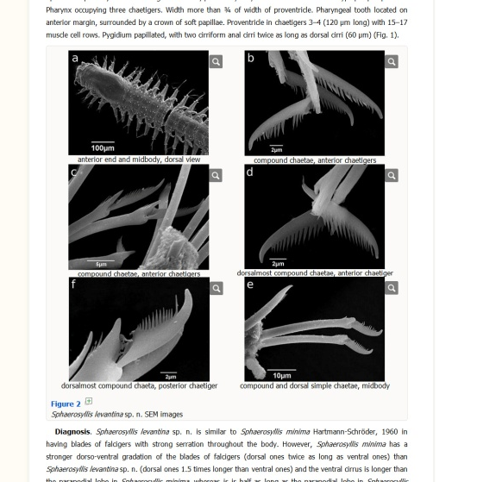
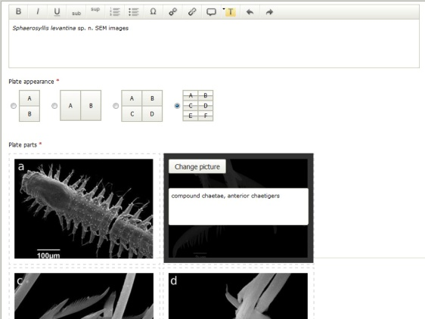
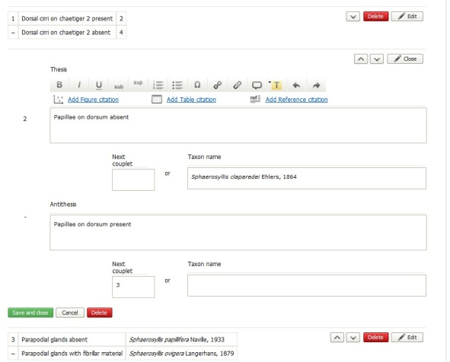
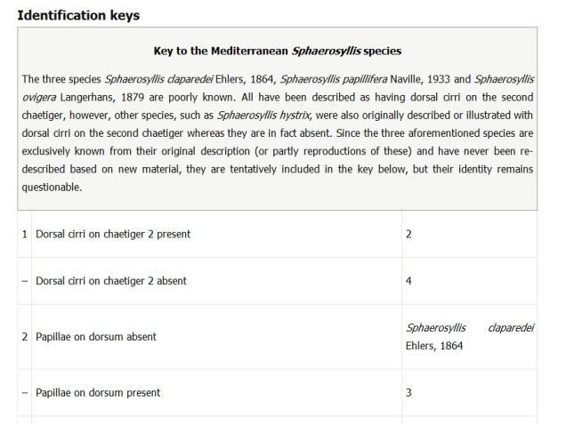
Several more features
Manuscript preview
Multi-figure plate builder
Plate layout
ID Key
builder
ID Key
preview

Slide 27
Submission stepS

Slide 28
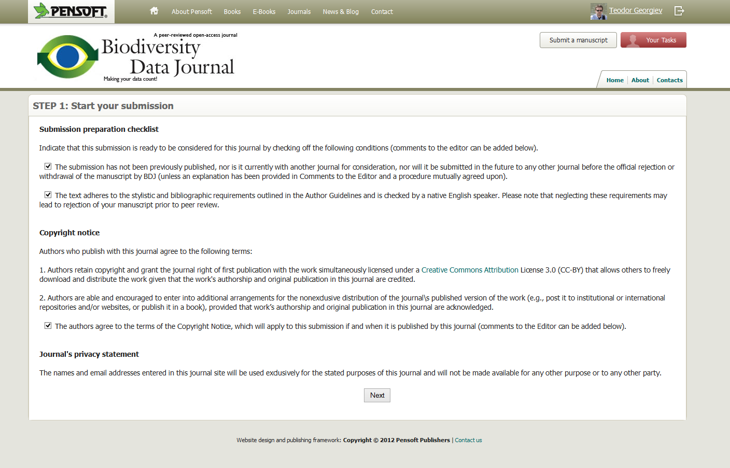
Submission steps

Slide 29
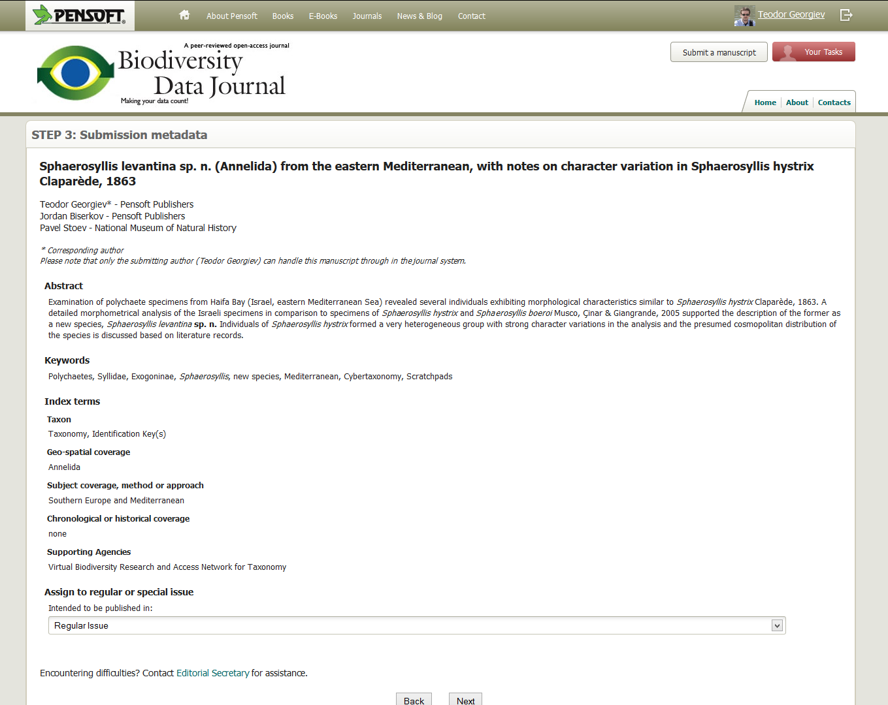
All metadata autom. transferred

Slide 30
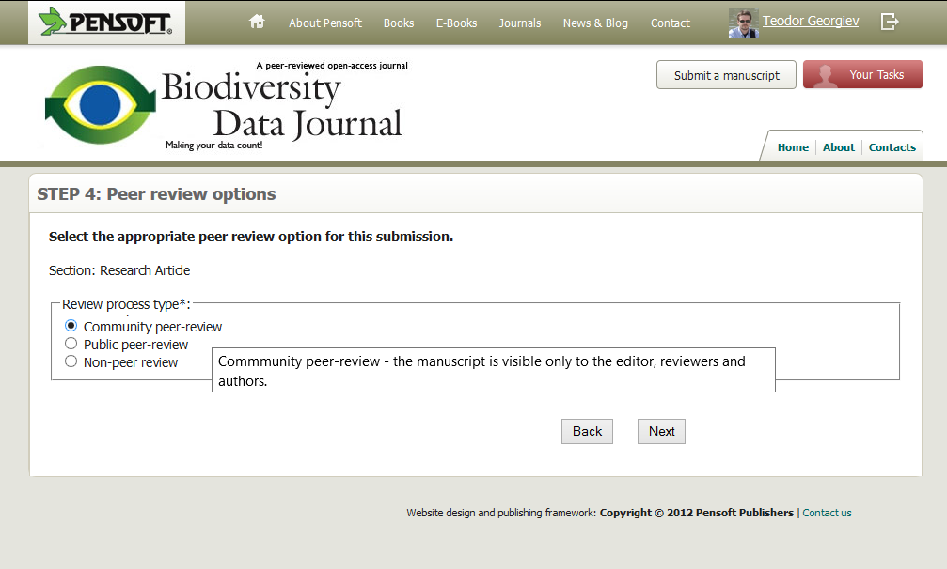
Authors can choose review types
Notes:
The type of the article determines the possible choices.
For example an editorial can be either non-peer or peer-reviewed,
while a taxonomic paper can only be peer-reviewed.

Slide 31
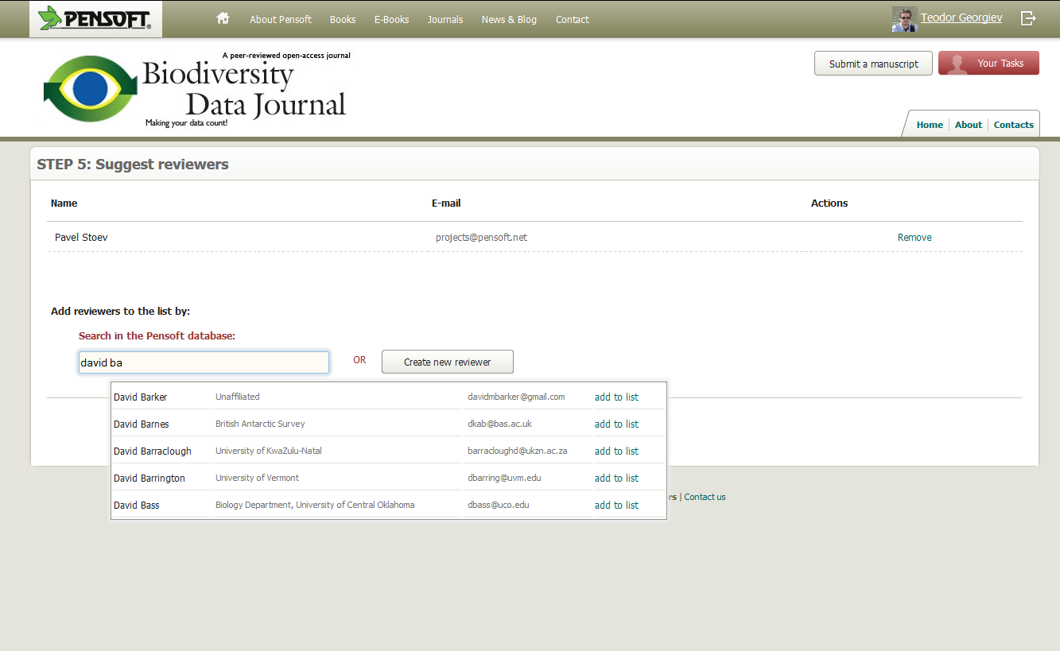
Authors can suggest reviewers

Slide 32
Manuscript views

Slide 33
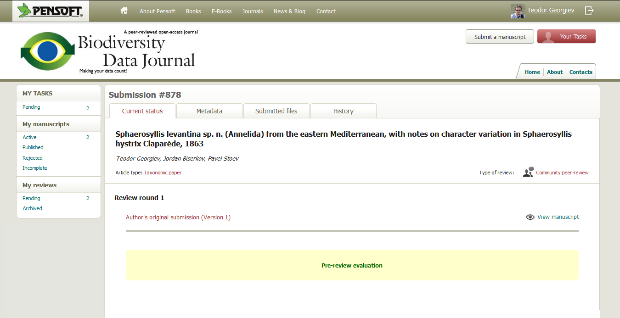
Author; manuscript submitted

Slide 34
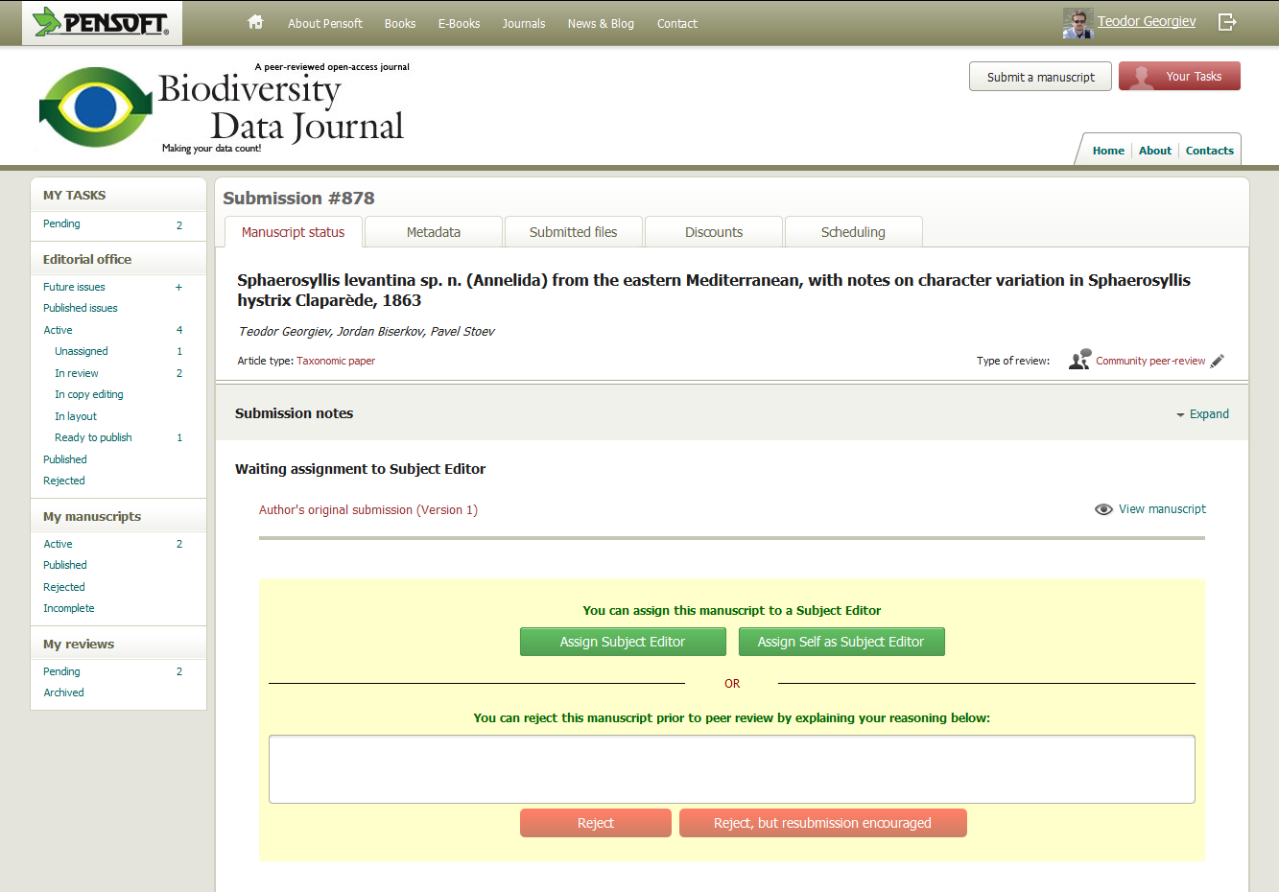
Editor; pre-review evaluation

Slide 35
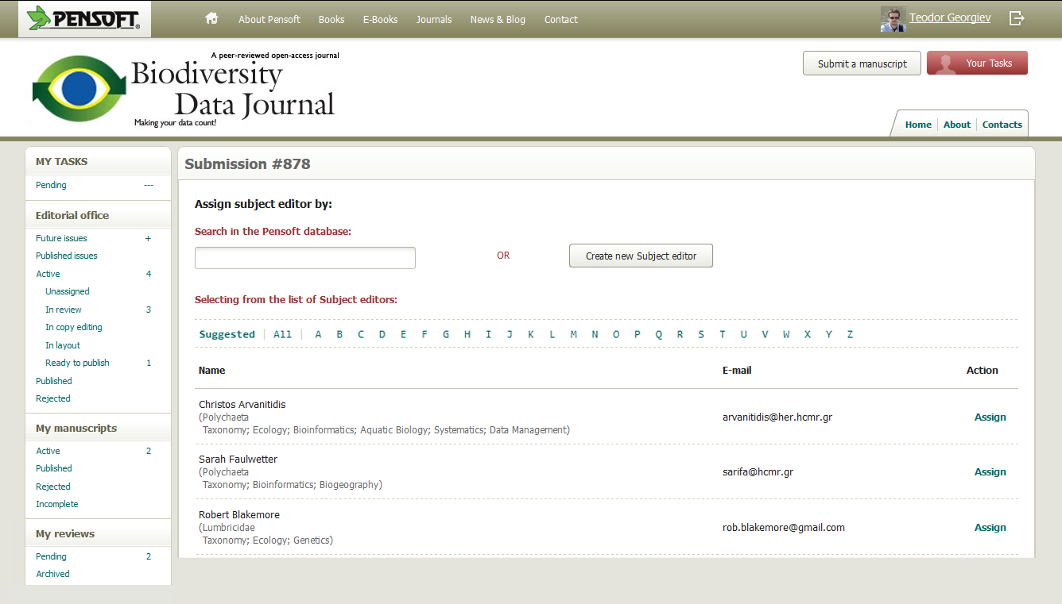
Editor; assign Subject editor

Slide 36
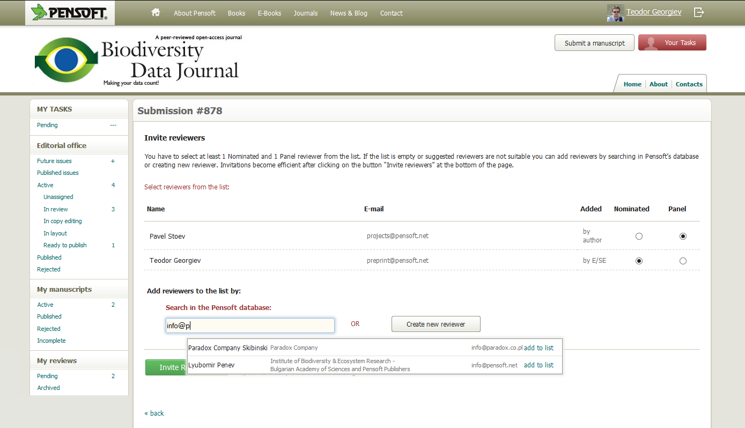
Subject editor; invite reviewers

Slide 37
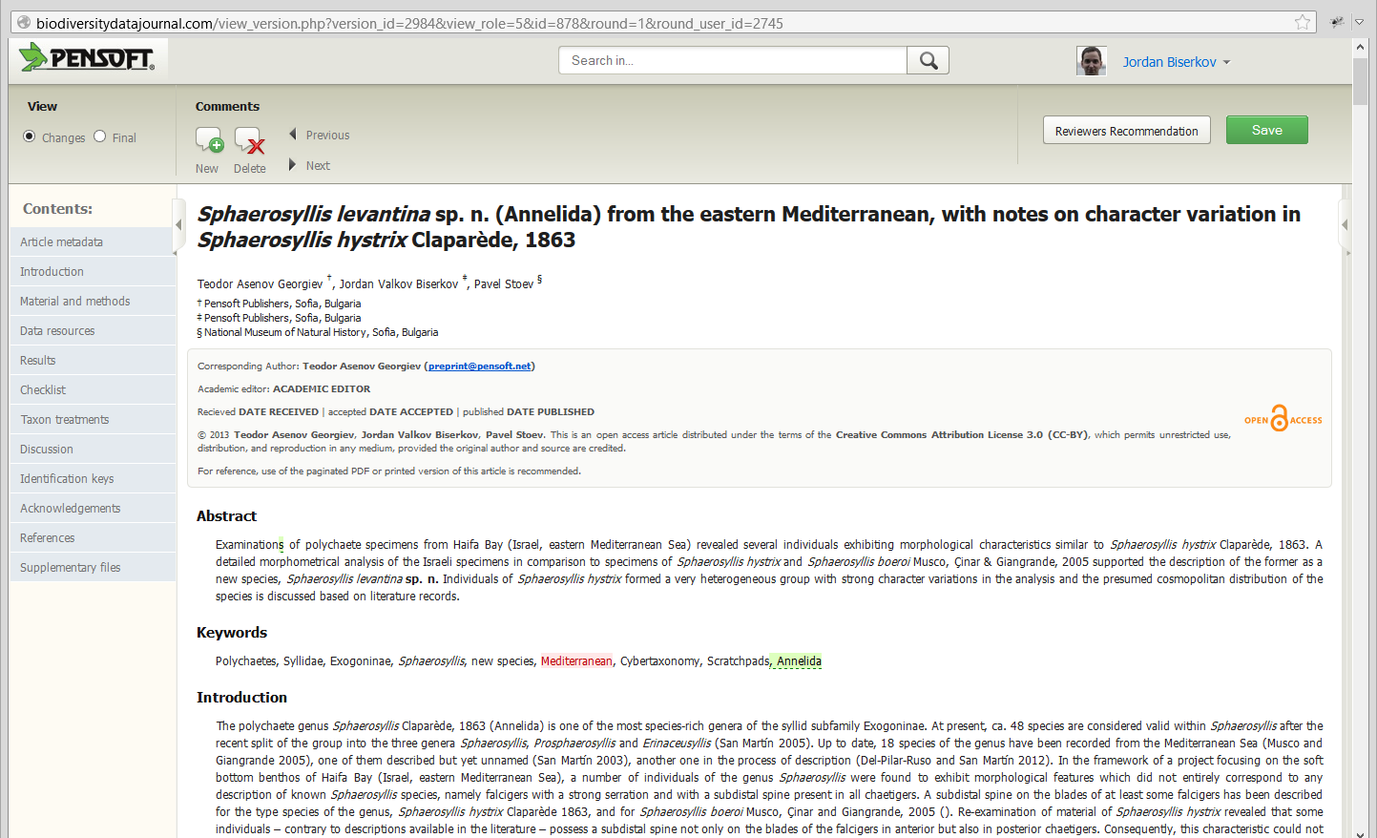
Online editing; changes tracking

Slide 38
Why publish in the BDJ?
Joining (small) data into a large data pool
Open-access, archiving and re-using your data
Citation record for data through peer-reviewed publications
Easy online authoring/editorial process for authors, reviewers and editors
Innovative dissemination of atomized content
Very low-cost! Free in the launch phase, thereafter at fee that anyone can afford!

Slide 39
BDJ will make your data count by:
Collating (small) data into a large data pool
Open-access, archiving and re-using your data through data aggregators
Providing citation record and creditability for data through peer-reviewed publications
Using innovative dissemination of atomized content
Low-cost model: Free in the launch phase, thereafter at a fee that anyone can afford!

Slide 40
What the experts say?
"Science is a combination of gathering facts and making theories; neither can progress on its own. [...]
In the history of science, the laborious accumulation of facts is the dominant mode, not a novelty."
Peter Norvig, Director of Research @ Google Inc.

Slide 41
Thank you for your attention!
ViBRANT
pensoft.net/journals/bdj
ViBRANT

