Slide 1
European Journal of Taxonomy
Laurence Bénichou
Muséum national d’Histoire naturelle

Slide 2

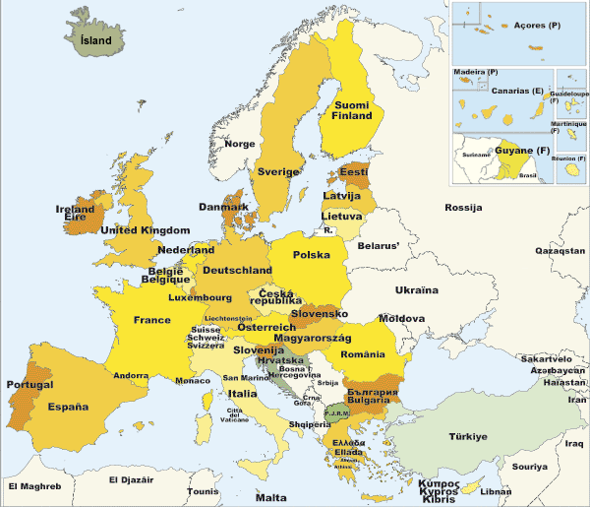
Scientific Publishing within Natural History Institutions
Creation of a network of staff involved in Scientific publishing within Natural History institutions under the European Distributed Institute of Taxonomy
=> 25 out of the 28 EDIT members are scientific publishers

Slide 3
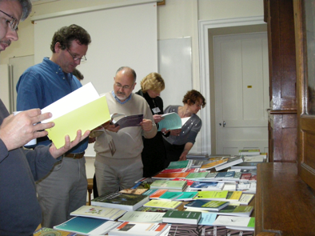
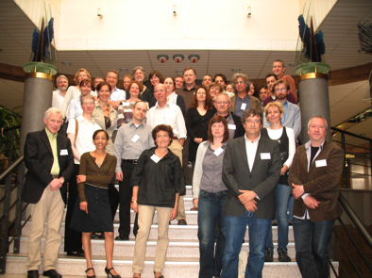
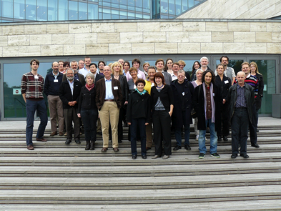
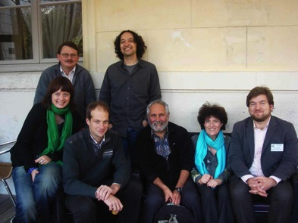
Aims and Objectives of the network
Catch up with the technology
Increase dissemination
Facilitate the transition to online OA publishing in our fields: take concerted actions to ensure we have crossed the electronic barriers
Set up a common policy of dissemination in natural history at European level
Reinforce collaborative partnerships
Promote dissemination of scientific information in natural history sciences
Address the technological changes and strategic decisions
Constitute and support a network which can:
  Face the technological change
  Weight on strategic decisions
  Enhance new standard
Paris 8th Dec. 2008
Bratislava 22^{nd-}23rd June 2009
Copenhagen 6^{th-}7th October 2010
Paris 20th Jan. 2011
Notes:
3

Slide 4

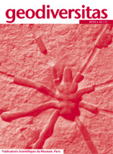

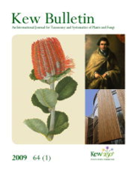

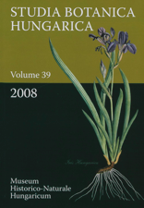


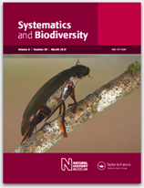


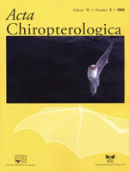


Most NHIs are traditionally scientific publisher
25 out of the 28 EDIT members are publishers; publishing ± 65 journals and ± 50 books and monographs series
Long standing journals: 1/3 of them are at least 60 year-old journals (16% > 100 year old).
78% are available online and 28% have an impact factor.
All the institutions have a same editorial process and policy.
but different business models.

Slide 5

All barriers to go online “nearly” solved
1. Technical answers have been provided to ensure sustainability of the online support and the access to the journal archives.
2. Nomenclature rules in zoology, botany do now recognise e-only publications as valid.
3. Library exchange programmes
4. Lack of personnel and resources

Slide 6










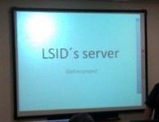






How to face the digital revolution?
TaxPub
CiteBank
DwC-A
TaxonX

Slide 7
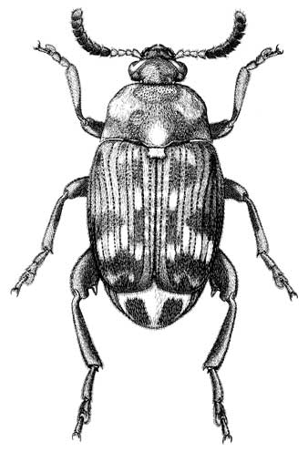
EJT, or How to kill three birds with one stone?
A joint journal would solve most of the problems identified:
Small journals (without IF) that fail to attract good papers
Good journals (with IF) that attract more papers than they can publish rapidly
Journals commercially outsourced that have lost editorial control (rush for ever increasing IF...)
Result: fewer institutional-driven communication channels for (alpha)taxonomy and these usually do not have wide circulation, encounter difficulties to go online and face the technological revolution
=> All can benefit from a joint initiative like EJT

Slide 8
EJT aims at enabling NHIs to
Increase the dissemination
Face the digital revolution
Control the editorial production

Slide 9


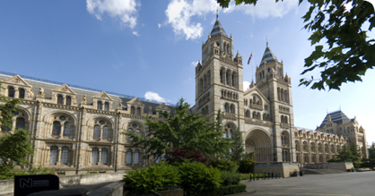


What is EJT ?
International, fully electronic, fast-track, open-access, peer-reviewed journal
in descriptive taxonomy, covering subjects in zoology (incl. Entomology), botany and palaeontology.
Ownership shared by the founding institutions
Truly global but firmly anchored in Europe
Some of the journals published by the institutions members of EJT will merge while others have chosen not to merge, for now.
Key aspects: its economic model; pool of resources and expertise; set-up of cross-institutional strategy at European level for taxonomy
www.europeanjournaloftaxonomy.eu

Slide 10
EJT promotes an alternative business model
Since it is their mission, NHIs will ensure, by way of a free Open Access (OA) journal, that publicly-funded research is easily, freely, and sustainably accessible to everyone who needs it
Free Open Access where
  neither the author
  nor the reader
  Has to pay subscription or article-processing charge
=> Costs are being borne by the founding institutions

Slide 11
EJT empowers publishing staff
Most of the time, within NHIs, journals are run by very isolated members of staff facing complex and strategic issues
The lack of technical and editorial staff in the institutions who would be able to address these issues is problematic, and results in a lack of knowledge in publishing field which prevents the institutions from being innovative in their mission to disseminate the scientific results
By pooling expertise and resources EJT will enable NHIs to build a strong network of skilled scientific publishing staff to share expertise and ensure the adoption of best practise
=> Learn from a competitive position

Slide 12
EJT promotes the set-up of a cross-institutional strategy
Gain in innovation and have a coordinated approach to their adoption
Take concerted actions to ensure that their journals and scientific production have crossed the electronic barrier and have moved into the digital world using similar standards and compatible tools
Establish a coherent set of policies using the same standards for metadata, data structures, technical standards, etc.
=> Coordinating institutional resources contributes to excellence, prevents repetition, and increases efficiency in the dissemination of taxonomic data

Slide 13
EJT structures

Slide 14








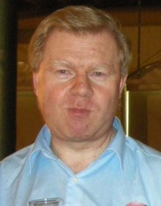

EJT’s team
EDITORS
Koen Martens, Editor-in Chief
Rudy Jocqué
Christian de Muizon
Thomas Janssen
EDITORIAL OFFICE
Charlotte Thionois
Paris, France
Laurence Bénichou
Publications manager
Natacha Beau,
Meise, Belgium
Danny Eibye-Jacobson
Copenhagen, Denmark
Kristiaan Hoedmakers
Brussels, Belgium
Chris Sleep,
London, UK

Slide 15
Statistics from 11th Sept. 2011 to 8th February 2013
Number of new taxa described (incl. genera and family) | 138
Number of manuscripts submitted | 70
Number of articles published | 38
Number of pages published | 1130
Average pages per articles | 29,7
Rejection rate | 28%
Average time line between submission and acceptation | 15 calendar weeks
Average time line between acceptation and publication | 4 calendar weeks
Average time line between submission and publication | 19 calendar weeks

Slide 16

Prospectives
Submission to useful databases
Providing articles in XML format
Promote EJT so as to welcome other institutions
Thanks for your attention

