Slide 1
What would convince editors to move into XML publishing?
Laurence Bénichou

Slide 2
Journals classification

Slide 3
1/3 of the new species described worldwide are described in a NFP journal
Journal title | New taxa
Zootaxa (magnolia press) | 11451 | 12.60%
Journal of Natural History (taylor & francis) | 1456 | 1.60%
Acta Zootaxonomica Sinica | 1202 | 1.32%
Journal of Paleontology | 1197 | 1.32%
Linzer Biologische Beitraege | 1190 | 1.31%
Annales Zoologici (Warsaw) | 922 | 1.01%
Revue Suisse de Zoologie | 867 | 0.95%
Paleontologicheskii Zhurnal (pleiades publishing) | 757 | 0.83%
Entomologica Basiliensia | 717 | 0.79%
Zoological Journal of the Linnean Society | 714 | 0.79%
10 top journals for new taxa from Index of Organism Names (from 2004 onwards)

Slide 4
Most editors are convinced that…
…it is part of their mission
…it will increase dissemination, which is the golden goal of any academic publication
…it shows excellence
Obstacles, difficulties encountered

Slide 5
Dep^{t} head
Define the editorial policy
Set policy and direction
Define the dissemination policy
Be alerted to technologic evolution
Negotiate with providers
Negotiate partnership
Negotiate copyright or license
Manage the staff
Manage the budget
Editorial manager
Author
Referee
Proof reading
Submit
a manuscript
Revise
Manage peer-review process
Check if everything is present
Spelling and typesetting check, double spaces, etc.
Standardize text, footnotes, bibliography (taking account of the norms of the field)
Check titles level
Check nomenclature
Image editing
Place in InDesign - styles
Read, correct text and image
Place figures
Questions to the author
Proofs to the author
Fix design of cover
Produce covers and index
Peer-review
Editor-in-chief
Advertise
Distribute
Manage subscriptions
Handle sales data and returns
Send copies for indexation to ISI, Georef, ASFA, Pascal, Biosis…
Desk-editor
Accepted
manuscript
PDF files
Printer
Binder
Online provider
Print copies
Stocks manager
Aggregator publisher
Sales manager
Library
Provide exchange copies
Book sellers
Customers

Slide 6
Scientist
Acting as reader
Library
Acting as author
Acting as editor
Acting as referee
Provide exchange copies
Editorial office
Aggregator publisher
PDF files
Print copies
Printer
Binder
Online provider
Book sellers
Acting as customer

Slide 7
Taxonomy and publication are intertwined
Taxonomic papers are legal documents that determine the legitimacy of a name of a (new) species
Key aspect of the taxonomic pub over the past 250 years has been descriptions of species = thus access to publications is critical to the field
Web has changed the way taxonomic research is conducted

Slide 8


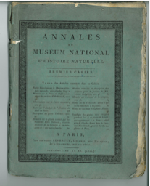







Most NHIs are publishers since their creation
25 out of 28 EDIT members are publishers
65 journals and 50ish book series
Vast majority of them publish taxonomic and systematic research and support in-house material
Long-standing journals: 30% are at least 60 year-old and 16% are older than 100 years old
In 2010, 1,450 new species were described among 33 of those journals (ie 8% of all species described worldwide)
Double mission of certification and dissemination
Low print run

Slide 9
Most editors are convinced that…
…it is part of their mission
…it will increase dissemination, which is the golden goal of any academic publication
…it shows excellence
Obstacles, difficulties encountered

Slide 10
Open Access will increase dissemination
Accessibility of the articles describing the marine species
Fontaine & Bouchet, unpublished data

Slide 11
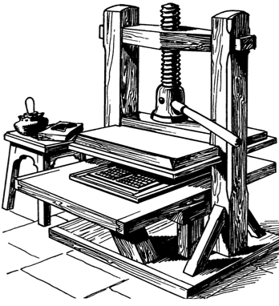
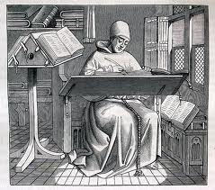
Agreement reached: Online access is the best way to disseminate the information but
PDF format enables the reader to access an article s/he is aware of
Xml format enables the reader to find the information s/he is unaware of

Slide 12
Most editors are convinced that…
…it is part of their mission
…it will increase dissemination, which is the golden goal of any academic publication
…it shows excellence
Obstacles, difficulties encountered

Slide 13




It shows excellence
1970 ISSN
2000 DOI
2010 LSID
LSID
Editing is structuring,
Speeds up the publication process? No but it will definitely speed up the accessibility and citability

Slide 14
Obstacles, difficulties
Understand the issues addressed by the digital revolution
Convince the decision makers
Deal with the technical issues: Lack of skilled staff involved in scientific publishing that would be able to address those issues
Find some fund to implement it
HOW WE CAN HELP
=> inform them
=> provide them with tools
=> agree on standards to disseminate the information and what kind of information we want to disseminate and share
Thank you for your attention

