Slide 1
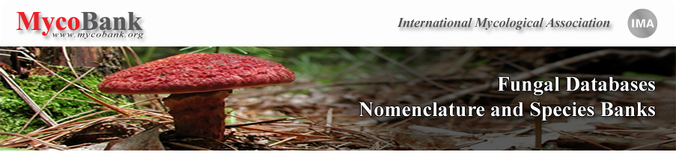
Mycobank and associated databases as working tools for taxonomists: opportunities and challenges
Vincent Robert
CBS-KNAW, Utrecht, The Netherlands, v.robert@cbs.knaw.nl

Slide 2
History & facts
Started in 2004.
P.W. Crous, W. Gams, J.A. Stalpers, V. Robert and G. Stegehuis. 2004. MycoBank: an online initiative to launch mycology into the 21st century. Studies in Mycology 50: 19–22
Originally based on a CBS Firebird database (J. Stalpers and G. Stegehuis) and an old version of BioloMICS software (V. Robert)
Started at CBS-KNAW but later transferred to International Mycological Association (IMA)
IMA is now the owner of MycoBank
Created to centralize deposit of new fungal taxa (species, genera, families, etc)

Slide 3
History & facts
Created to know what has been published until now and provide an exhaustive and centralized list of fungal species
More and more data associated with taxa have been added to MycoBank
MB numbers required by a majority of journals publishing new taxa
New version of MycoBank released in April 2012 with a number of new features:
  Complete integration with BioloMICS software allows extensive developments of new features
  Simplified basic and advanced search engine
  Simplified registration of new taxa

Slide 4
History & facts
New version of MycoBank released in April 2012 with a number of new features:
  Complete integration with BioloMICS software allows extensive developments of new features
  Simplified basic and advanced search engine
  Simplified registration of new taxa
  Link out to many websites:
    1. DBs containing fungi:
    a. Catalogue of Life (CoL)
    b. Encyclopedia of Life (EOL)
    c. Global Biodiversity Information Facility (GBIF)
    d. Index Fungorum (IF)
    e. Integrated Taxonomic Information System (ITIS)
    2. Bibliography links :
    a. Google Scholar
    b. PubMed
    c. Libri Fungorum
    d. Biblioteca Digital
    e. Biodiversity Heritage Librar
3. General links :
a. Google
b. Wikimedia
c. Wikipedia
d. Wikispecies
4. Molecular links :
a. BOLD Systems
b. EMBL
c. NCBI
5. Specimens and strains links :
a. All Russian Collection of Microorganisms (VKM)
b. CBS collection
c. StrainInfo
d. WDCM will be made available as soon as ready

Slide 5

History & facts
Distributed Fungal Databases
Clinical ITS
488
Aspergillus
341
Stage 1
Penicillium
430
Genbank
+++
Mycosphaerella
117
Colletotrichum
452
Calonectria
160
Phytophtora
77
MLST
Fusarium
1365
Phoma
309
CBS
26098
FunBOL
4366
BOLD
Yeasts
1365
Indoor molds
1646
Pasteur
-+5000
Ceratocystis
92
Monilinia
54
Stenocarplella
32
Russula
608
Dermatophytes
378
Phaeoacremonium
30
Medical
315
CDC

Slide 6
History & facts
New version of MycoBank released in April 2012 with a number of new features:
  Complete integration with BioloMICS software allows extensive developments of new features
  Simplified basic and advanced search engine
  Simplified registration of new taxa
  Link out to many websites
  Pairwise sequence alignments against a large number of websites including CBS and GenBank (BOLD soon as well)
  Polyphasic identifications for a number of taxonomic groups

Slide 7
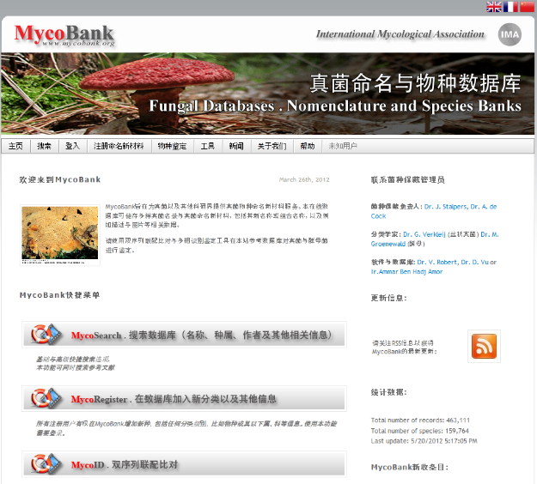
History & facts
New version of MycoBank released in April 2012 with a number of new features:
  Multilingual:
    English, French, Chinese, German, Arabic, Spanish, Portuguese and Dutch are available. Thai ready but not yet published.
    Russian, Indonesian and Japanese coming soon
    More if volunteers are ready to translate the system in their own languages

Slide 8
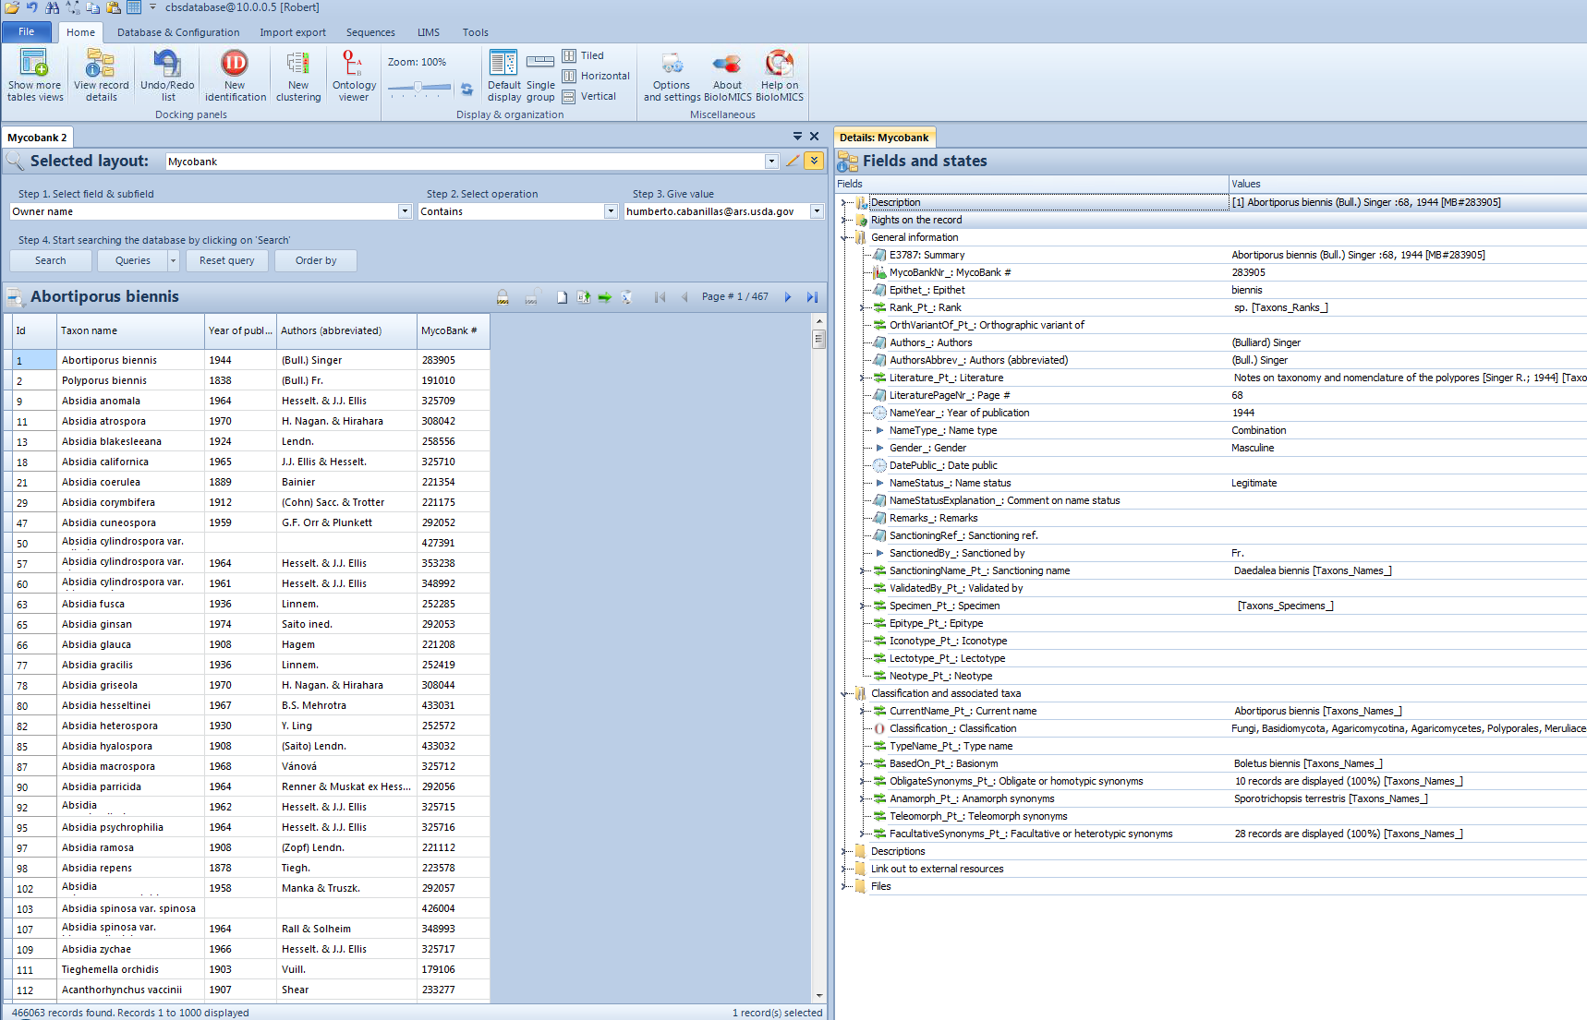
History & facts
New version of MycoBank released in April 2012 with a number of new features:
  Multilingual
  Remote curation of MycoBank allows curators from all around the world to manage the system, will be effectively available in April 2013.

Slide 9
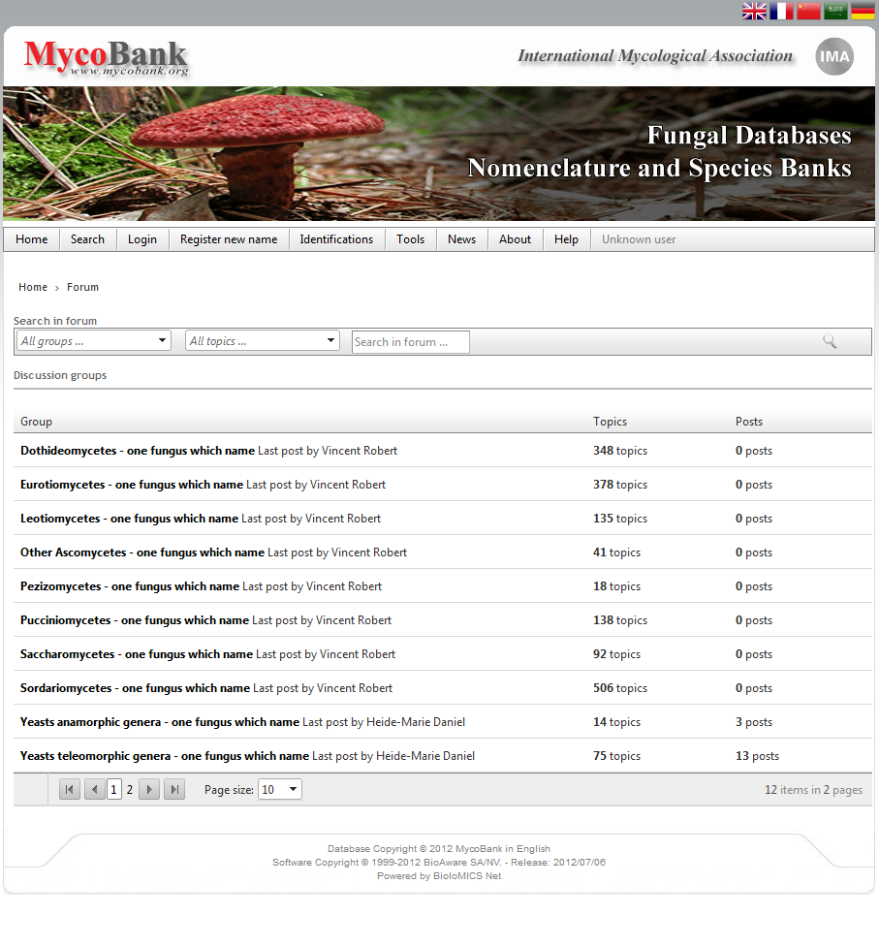
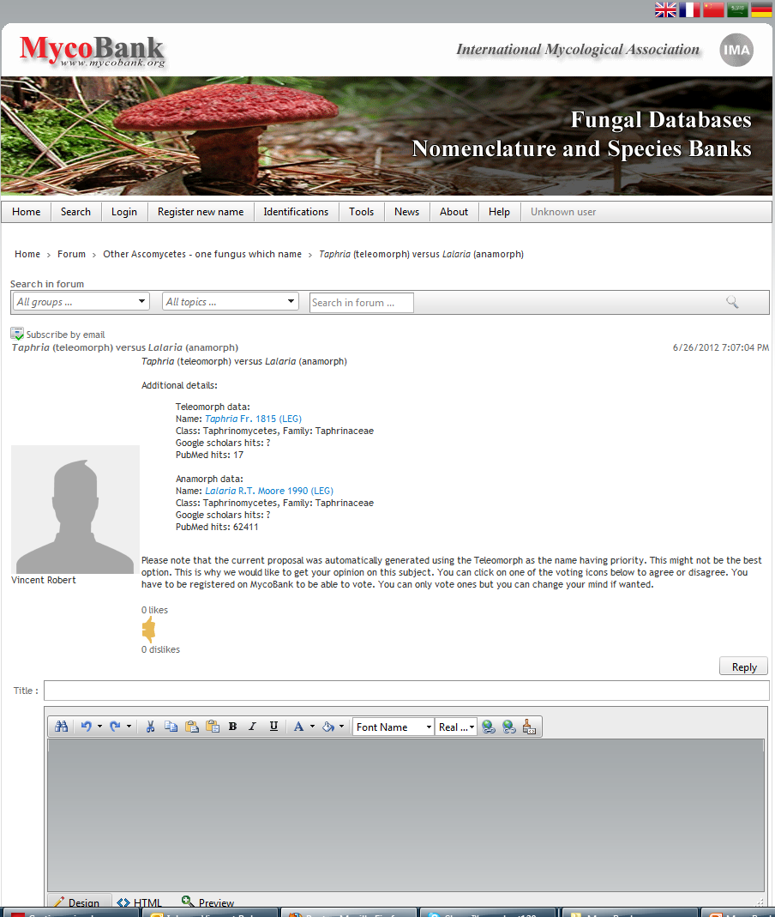
Discussion panels & annotations

Slide 10
Fungal repositories synchronization
Central facility
Unique number for names
Avoid duplication
Live synchronization
Ensure data consistency
Ensure minimum dataset
Help curation
Fungal Names
China
MycoBank
Index Fungorum

Slide 11
Fungal repositories synchronization
Dynamic REST (SOAP soon) protocol and allows many operators and complex queries:
  =
  <
  >
  <=
  >=
  <>
  STARTSWITH
  ENDSWITH
  CONTAINS
  AND
  OR
  NOT
  (
  )
<Taxon>
<ID>1213321</ID>
<MycoBank_Number>800624</MycoBank_Number>
<Taxon_Name>Candida mycobankii</Taxon_Name>
<Authors>J. Smith</Authors>
<Rank>Species</Rank>
<Higher_Rank_ID>4569</Higher_Rank_ID>
<Higher_Rank_Name>Candida</Higher_Rank_Name>
<Status>Legitimate</Status>
<Published>True</Published>
…
</Taxon>
<Taxon>
<ID>1213322</ID>
<MycoBank_Number>800625</MycoBank_Number>
<Taxon_Name>Candida bertreensis</Taxon_Name>
<Authors>J. Smith</Authors>
<Rank>Species</Rank>
<Higher_Rank_ID>4569</Higher_Rank_ID>
<Higher_Rank_Name>Candida</Higher_Rank_Name>
<Status>Legitimate</Status>
<Published>True</Published>
…
</Taxon>

Slide 12
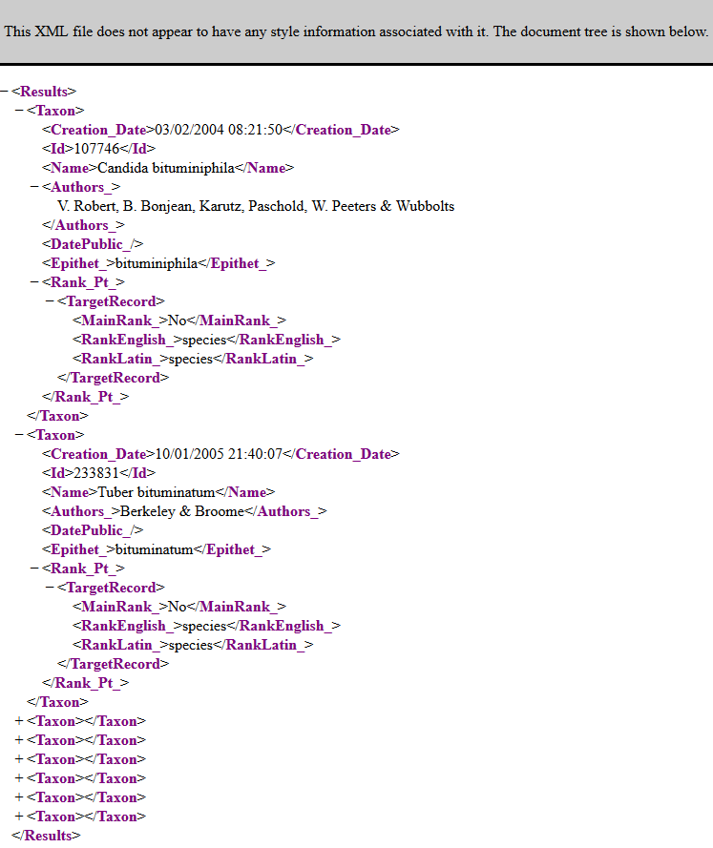
Fungal repositories synchronization
Example:
http://www.mycobank.org/services/generic/searchservice.svc/rest/xml?layout=14682616000000161&limit=1000&filter=Epithet_ STARTSWITH “bitum”
<Results><Taxon><Creation_Date>03/02/2004 08:21:50</Creation_Date><Id>107746</Id><Name>Candida bituminiphila</Name><Authors_>V. Robert, B. Bonjean, Karutz, Paschold, W. Peeters & Wubbolts</Authors_><DatePublic_/><Epithet_>bituminiphila</Epithet_><Rank_Pt_><TargetRecord><MainRank_>No</MainRank_><RankEnglish_>species</RankEnglish_><RankLatin_>species</RankLatin_></TargetRecord></Rank_Pt_></Taxon><Taxon></Taxon><Taxon></Taxon><Taxon></Taxon><Taxon></Taxon><Taxon></Taxon><Taxon></Taxon><Taxon></Taxon></Results>

Slide 13
Fungal repositories synchronization
Web services available for:
Queries and data retrieval
Insertion of new records/names (identification needed, only for a few registered submitters (MycoBank, IF, FN, MycoKeys ?, MycoSpecies, etc ?))
Update of existing records/names (identification needed, only for a few registered submitters (MycoBank, IF, FN, etc ?) and some fields)

Slide 14
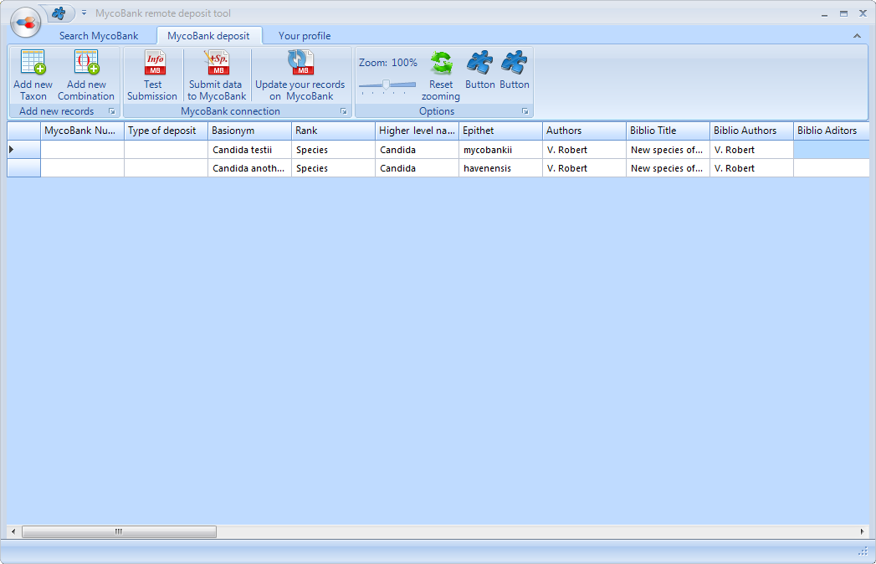
Remote MycoBank

Slide 15

Future developments
Microbiome analysis, metagenomics
Genome
Mix samples
NGS

Slide 16





Future developments
Database scaling needed

Slide 17



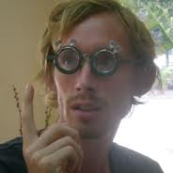
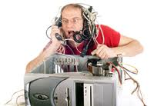







Future developments
Database scaling needed
NOSQL
Bioinformaticians
IT & Software developers

Slide 18

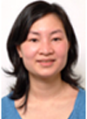

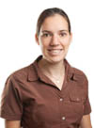


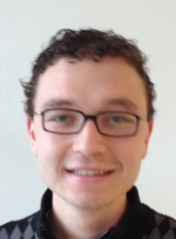
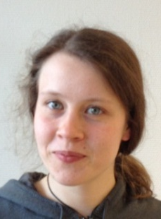
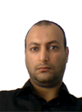


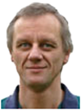
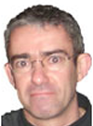

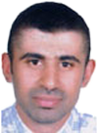
THE TEAM
V. Robert
(G. Stegehuis)
F. Borges dos Santos
D. Vu
N. van de Wiele
Lea Vaas
Joost Stalpers
Arthur de Cock
Utrecht, The Netherlands
MycoBank curation, Utrecht, The Netherlands
S. Ben Daoud
A. Ben Hadj Amor
O. Chouchen
M. Jaidane
S. Szoke
B. Jabas
E. Blom
Sousse, Tunisia
Hannut, Belgium

Slide 19

Thanks to all mycologists, developers, EU, NCB, FES, Embarc, Sloan Foundation, QBOL, q-Bank, & iBOL projects
10
Conrad L. Schoch¹, Keith A. Seifert², Sabine Huhndorf³, Vincent Robert⁴, John L. Spouge¹, Elena Bolchacova⁵, Kerstin Voigt⁶, Wen Chen², Andrew N. Miller⁷, Michael J. Wingfield⁸, M. Catherine Aime⁹, Kwang-Deuk An¹⁰, Feng-Yan Bai¹¹, Robert W. Barreto¹², Dominik Begerow¹³, Marie-Josée Bergeron¹⁴, Meredith Blackwell¹⁵, Teun Boekhout⁴, Mesfin Bogale¹⁶, Nattawut Boonyuen¹⁷, Ana R. Burgaz¹⁸, Bart Buyck¹⁹, Lei Cai¹¹, G. Cardinali²⁰, Priscilla Chaverri²¹, Brian J. Coppins²², Ana Crespo¹⁸, Pedro W. Crous⁴, Paloma Cuibas¹⁸, Ulrike Damm⁴, Z. Wilhelm De Beer⁸, G. Sybren De Hoog⁴, Ruth Del-Prado¹⁸, Bryn Dentinger^{23,56}, Javier Diéguez-Uribeondo²⁴, Pradeep K. Divakar¹⁸, Brian Douglas²⁵, Margarita Dueñas²⁴, Duong Vu⁴, Tuan A. Duong²⁶, Ursula Eberhardt⁴, Mostafa S. Elshahed²⁷, Katerina Fliegerova²⁸, Miguel A. García²⁴, Zai-Wei Ge²⁹, Gareth W. Griffith²⁵, K. Griffiths³⁰, Johannes Z. Groenewald⁴, Marizeth Groenewald⁴, Martin Grube³¹, Marieka Gryzenhout³², Liang-Dong Guo¹¹, Ferry Hagen⁴, Sarah Hambleton², Richard C. Hamelin¹⁴, Karen Hansen³³, Paul Harrold²², G. Heller⁹, Kazuyuki Hirayama³⁴, Hsiao-Man Ho³⁵, Kerstin Hoffman⁶, Valérie Hofstetter³⁶, Filip Högnabba³⁷, Peter M. Hollingsworth²², Seung-Beom Hong³⁸, Kentaro Hosaka³⁹, Jos Houbraken⁴, Karen Hughes⁴⁰, Seppo Huhtinen⁴¹, Kevin D. Hyde^{43,44}, Timothy James⁴⁴, Peter R. Johnston⁴⁵, E.B. Gareth Jones¹⁷, Laura J. Kelly^{22,23}, Paul M. Kirk⁴⁶, Dániel G. Knapp⁴⁷, Urmas Kõljalg⁴⁸, Gábor M. Kovács⁴⁷, Cletus P. Kurtzman⁴⁹, Sara Landvik⁵⁰, Steven D. Leavitt³, André Levesque², Audra S. Liggenstoffer²⁷, Kare Liimatainen⁵¹, Lorenzo Lombard⁴, J. Jennifer Luangsa-ard⁵², H. Thorsten Lumbsch³, Harinad Maganti⁵³, Sajeewa S. N. Maharachchikumbura⁴², María P. Martin²⁴, Tom W. May³⁰, Alistair R. McTaggert⁹, Andrew S. Methven⁵⁴, Wieland Meyer⁵⁵, Jean-Marc Moncalvo⁵⁶, S. Mongkolsamrit⁵², László G. Nagy⁵⁷, R. Henrik Nilsson⁵⁸, Tuula Niskanen ⁵¹, ldikó Nyilasi⁵⁷, Gen Okada¹⁰, Izumi Okane⁵⁹, Ibai Olariaga⁶⁰, J. Otte⁶¹, Tamás Papp⁵⁷, Duckhul Park⁴⁵, Tamás Petkovits⁵⁷, Raquel Pino-Bodas²⁴, C. Qing²⁹, Willem Quaedvlieg⁴, Huzefa A. Raja⁶², Dirk Redecker⁶³, Tara Rintoul², Constantino Ruibal¹⁸, J.M. Sarmiento-Ramírez²⁴, Imke Schmitt^{61,64}, Arthur Schüßler⁶⁵, Carol Shearer⁶⁶, Kozue Sotome⁶⁷, Frank O.P. Stefani³⁰, Soili Stenroos³⁷, Herbert Stockinger⁶³, Satinee Suetrong¹⁷, Sung-Oui Suh⁶⁸, Gi-Ho Sung³⁸, Motofumi Suzuki¹⁰, Kazuaki Tanaka³⁴, Leho Tedersoo⁶⁹, M. Teresa Telleria²⁴, Eric Tretter⁷⁰, Wendy A. Untereiner¹⁶, Hector Urbina¹⁵, Csaba Vágvölgyi⁵⁷, Agathe Vialle¹⁴, Grit Walther⁴, Qi-Ming Wang¹¹, Bevan S. Weir⁴⁵, Michael Weiß⁷¹, Merlin M. White⁷⁰, Jianping Xu⁵³, Rebecca Yahr²², Z.-L. Yang²⁹, Andrey Yurkov¹³, Juan-Carlos Zamora²⁴, Ning Zhang⁷², Wen-Ying Zhuang¹¹ and David Schindel, Szaniszlo Szoke, Bernard Jabas, Ammar Amor, Oussema Chouchen, Samy Ben Daoud, Ahemd Dridi, Samrock, Matteo Garbelotto, David Yarrow, Joost Stalpers, Gerrit Stegehuis, Nathalie van de Wiele, Donald Hobern, Matt Branford , Frank Bisby, Peter Bonants, Harm Huttinga, Sloan Foundation, Embarc project, EU grants QBOL, FES project, NCB Project, i4Life project, CBS, My wife and kids

