Slide 1
What is a Flora?
Peter Hovenkamp

Slide 2
What is not a Flora?
Labwork/ecology paper
Species selection on non-taxonomic criteria
No identification tool
Character selection other than diagnostic value
One specimen?

Slide 3
What is not a Flora?
Taxonomic monograph
  All species
  All synonyms/Types
  No geographic limitation
  All characters
  Full ecology
  All specimens

Slide 4

What is not a Flora?
Checklist
  All species
  Synonyms/Types
  Strong geographic limitation
  No characters
  Ecology
  All specimens

Slide 5
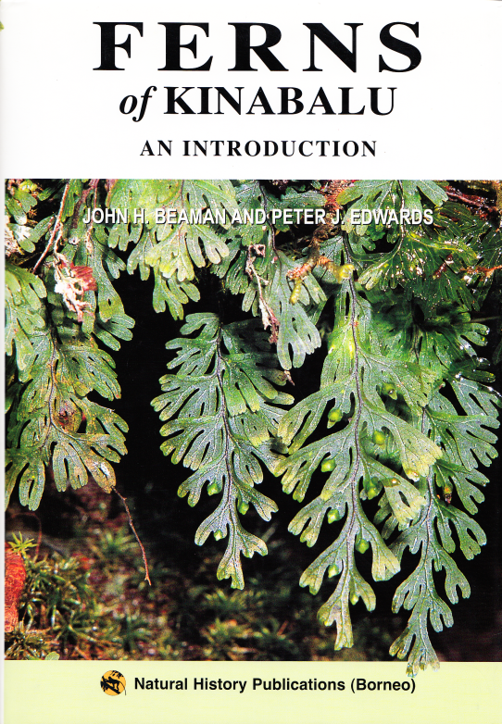
What is not a Flora?
Popular/field guide
  Species selection by taxonomy
  Strong geographic limitation
  Pictorial characters
  Ecology

Slide 6
What it takes to be a Flora
Taxonomic scope higher than Order level
Species selection by geography
Synonyms listed
Species identification tool provided (key, notes)
Characters listed (as opposed to depicted)
Distribution listed
Ecology listed

Slide 7
What is allowed in a Flora
Taxonomic scope
Green plants
Algae
Fungi…
Species selection
Geography
Ecology

Slide 8
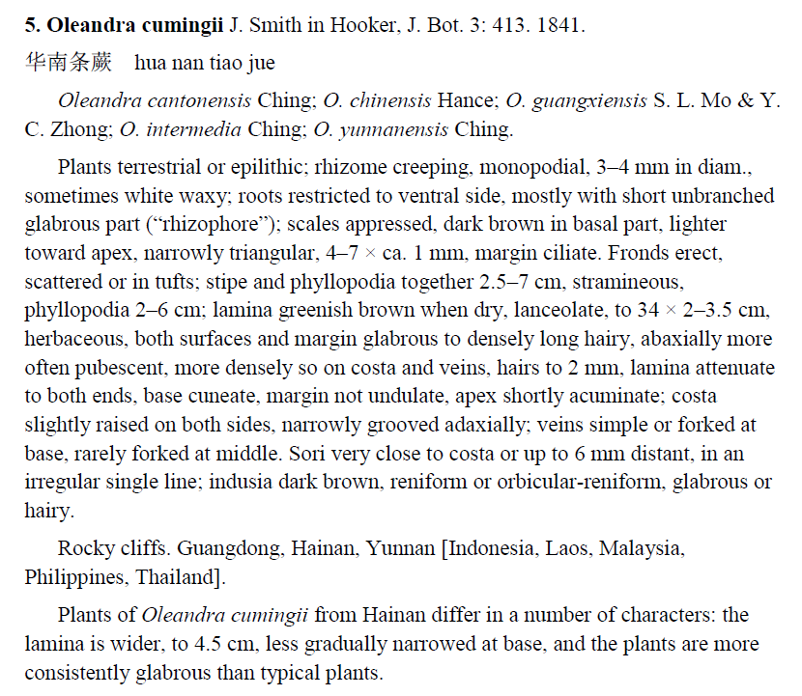
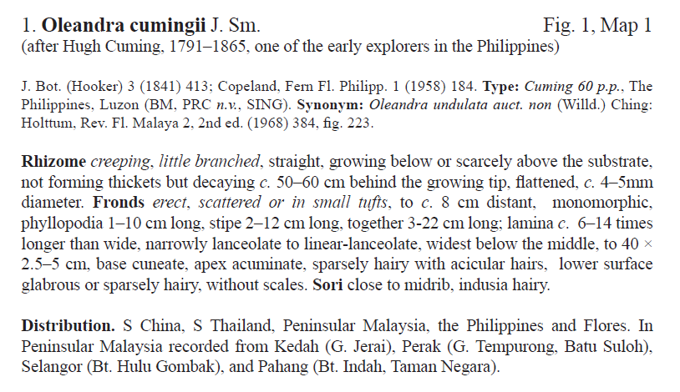
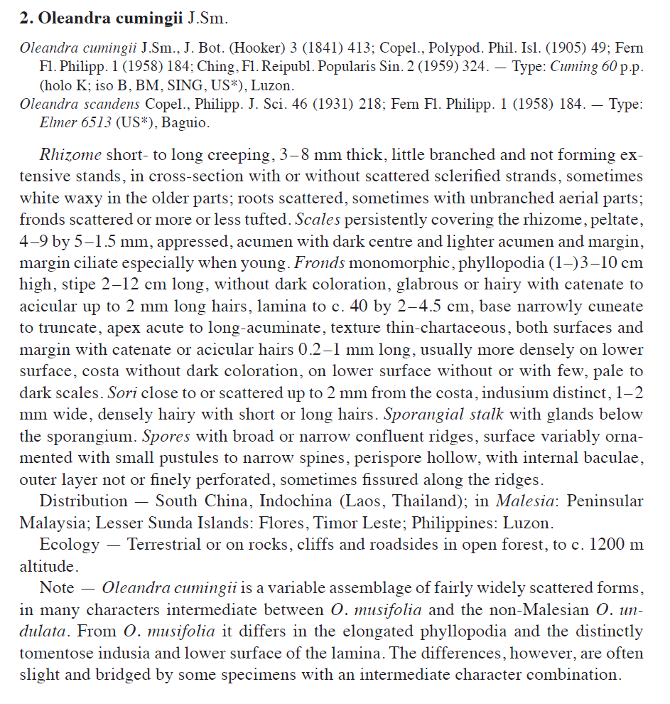
What is allowed in a Flora
Synonyms
limited by relevance
listed in full
Types
Detailed list
No details

Slide 9
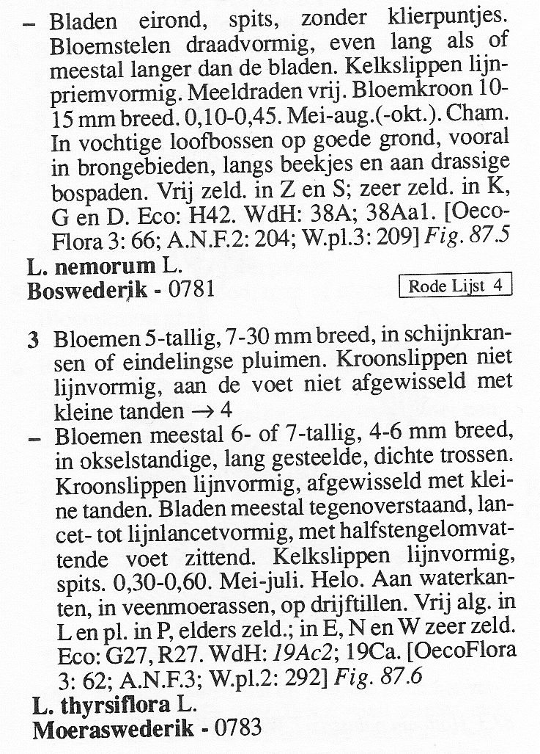
What is allowed in a Flora
Identification tool
Separate key
No separate key
Characters
Implicit in keys
Explicit descriptions
Selected by diagnostic relevance

Slide 10
What is allowed in a Flora
Additional data in various degree of detail

Slide 11
What a Flora does
Standardizes usage
Status
presence
native
introduced
Names
Common
Scientific
Species concepts
Genus, Family classification
Facilitates
Identification
Communication
Data retrieval

Slide 12
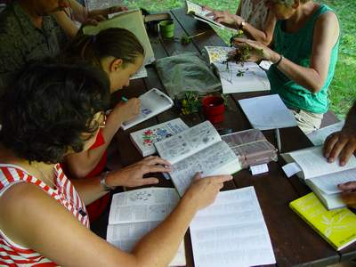
What a Flora needs to be effective
Awareness
Availability
Accessibility
Authority
Source: KNNV

Slide 13

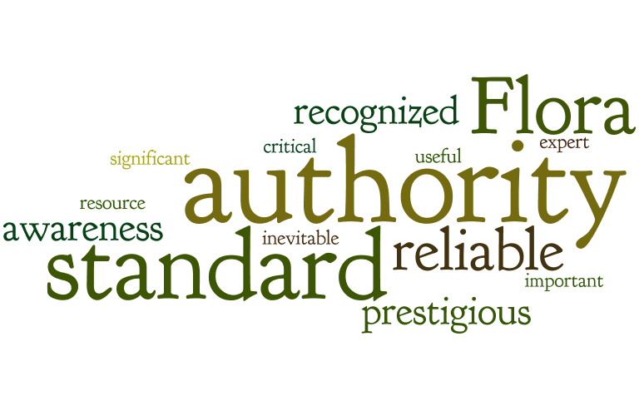
How a Flora can be effectively promoted

Slide 14
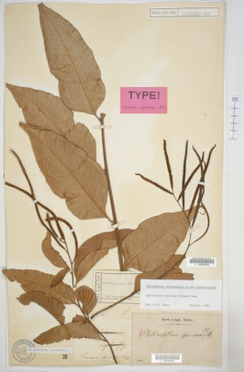
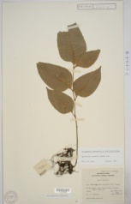
What it takes to write a Flora
Basic data
Type specimen metadata
Basionym
Collection metadata
Collector + number
Collection date
Collection locality
Ecology
…
Collection metadata
Collector + number
Collection date
Collection locality
Ecology
…

Slide 15
What we do when we write a Flora
Enriched data
Observations
Character/state
Character/state
Character/state
Character/state
…
Type specimen metadata
Basionym
Literature
Protologue
conspecificity
Collection metadata
Collector + number
Collection date
Collection locality
Ecology
…
Collection metadata
Collector + number
Collection date
Collection locality
Ecology
…
Observations
Character/state
Character/state
Character/state
Character/state
…

Slide 16
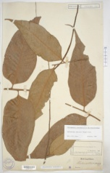
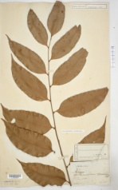
What it means to write a Flora
aggregation
Nomenclature
Description
Distribution
Ecology
Notes
literature
literature
Species concept
Metadata
Metadata
Observations
aggregation
Observations
Observations
Observations
Metadata
aggregation
Metadata
Metadata
Metadata

Slide 17
How Flora’s differ:
Editorial decisions during aggregation

Slide 18

VISION!

Slide 19
What I do when I write a Flora
Observations
Observations
Observations
Observations

Slide 20
What I want to do when I write a Flora
Species concept
Observations
Observations
Observations
Observations

Slide 21
What I really want
aggregation
Nomenclature
literature
literature
Species concept
Metadata
Metadata
Description
Observations
aggregation
Observations
Observations
Observations
Metadata
aggregation
Distribution
Ecology
Notes
Metadata
Metadata
Metadata

Slide 22
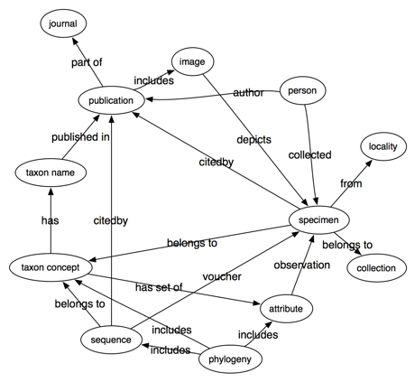
How this may be achieved?
is conspecific with
me
(thanks to Rod Page)

Slide 23
How this may be achieved?
is conspecific with
My colleague
is conspecific with
Species concept
is conspecific with
me
(thanks to Rod Page)

Slide 24
How this may be achieved?
Species concept

